Slide 1
Chapter 5
Growth Factors, Receptors, and Cancer
Oct 27, 2023
Notes:
前2节课讲述重要oncogene的发现，接下来2章讲这些重要oncogene，如src, erbB, ras如何发挥作用，研究表明这些Oncogene基本上都是通过生长因子，受体信号通路发挥功能。

Slide 2
Outline of today`s lecture
1. Growth factor and receptor tyrosine kinase signaling;
2. Other types of receptor signaling;
(Cytokine receptor; TGF-β receptor; Notch receptor; Patched-Smoothened; Frizzled receptor; GPCR; Integrin; Nuclear receptor )
3. How Ras function?
Notes:
Ras: Rat sarcoma virus oncogene; The first two ras genes, HRAS and KRAS, were identified from studies of two cancer-causing viruses, the Harvey sarcoma virus and Kirsten sarcoma virus. These viruses were discovered originally in rats during the 1960s by Jennifer Harvey and Werner Kirsten, respectively, hence the name Rat sarcoma,

Slide 3
How oncogene Src, Ras function?
The discovery of oncogenes and their precursors, the proto-oncogenes, stimulated a variety of questions. The most pointed of these centered on the issue of how the oncogenes, acting through their encoded protein products, succeed in perturbing cell behavior so profoundly. A variety of cell phenotypes were concomitantly altered by the actions of oncoproteins such as Src and Ras, the products of the src and ras oncogenes. How could a single protein species succeed in changing so many different cellular regulatory pathways at the same time?
Signaling transducing pathways, in molecular biology, cells managed to pass signal to variety of molecular machineries.
Notes:
How src and ras, first and important oncogene function?

Slide 4
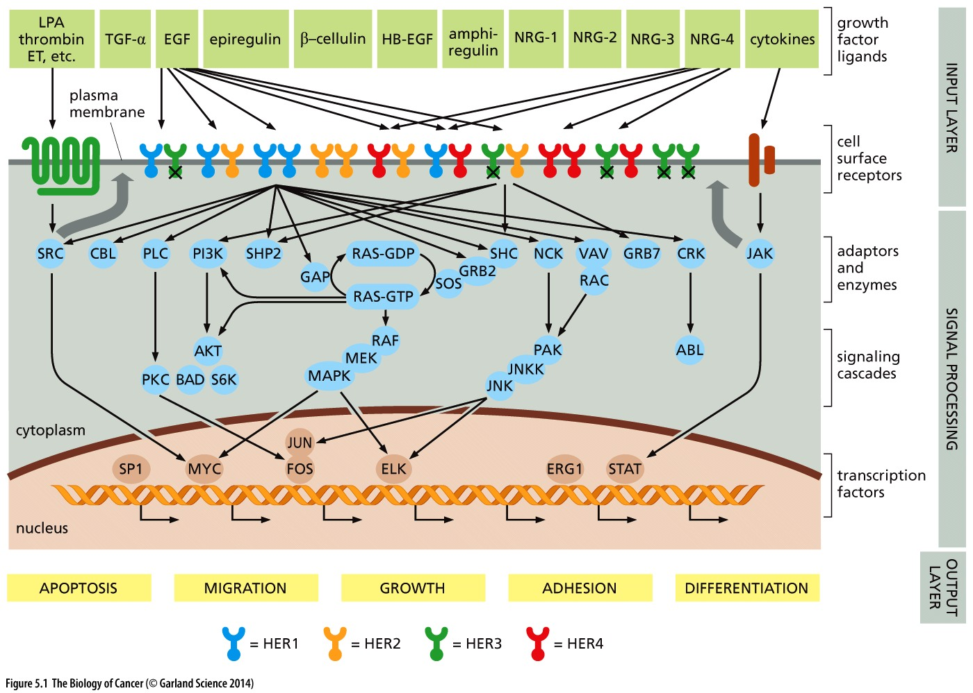
Figure 5.1 The human EGF receptor (HER) signaling network: how cells communicate with their surroundings
Notes:
信号转导图的第一印象，图片具体内容不需要记忆，供参考

Slide 5
5.1 Normal metazoan cells control each other’s lives
Notes:
信号转导的本质：细胞之间，细胞与环境交流的途径

Slide 6
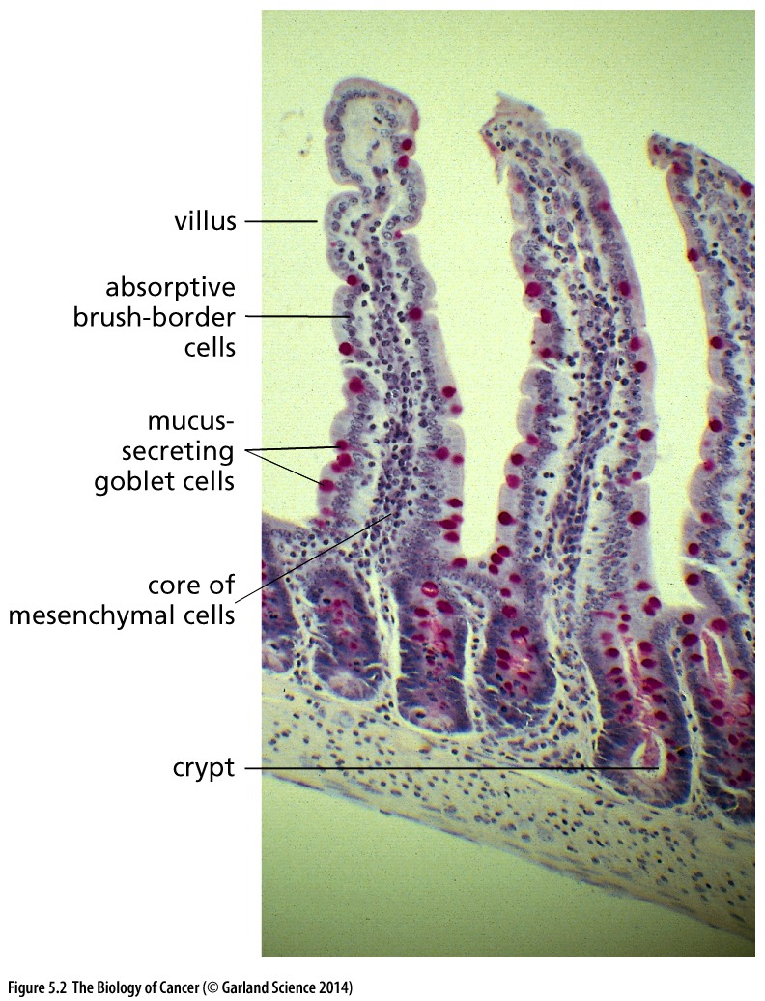
Figure 5.2 Maintenance of tissue architecture
The epithelial lining of the small intestine shown here illustrates the fact that a number of distinct cell types coexist within a tissue. The relative numbers and positions of each cell type must be tightly controlled in order to ensure proper tissue structure and function. This control is largely achieved via the exchange of signals between neighboring cells within the tissue.
Typical example for tissue stem cell regeneration
Notes:
小肠细胞系统，研究干细胞，信号转导的经典模型

Slide 7
Growth factors
Cells in a living tissue are constantly talking to one another. Much of this incessant chatter is conveyed by growth factors (GFs). Growth factor are relatively small proteins that are released by some cells.
Growth factors versus cytokines: Growth factor and cytokine both are small proteins. Historically, cytokines were associated with hematopoietic (blood forming) cells and immune system cells.
Notes:
growth factors 是细胞之间互相交流的媒介，意大利生物学家丽塔·莱维·蒙塔尔奇尼和美国生物化学家斯坦利·科恩因为共同发现了控制细胞生长和发育的因子——神经生长因子（NGF）和表皮生长因子（EGF）而获得1986年诺贝尔医学奖和生理学奖。EGF在美容产业应用，EGFR蛋白的发现始于70年代

Slide 8
PDGF
Platelet-derived growth factor (PDGF),
one of the first growth factor identified.
Serum（血清）, blood clot, take the remain cell-free liquid
Plasma（血浆）, remove cells from blood without clotting;
Serum, but not plasma stimulate cell division
PDGF helps wound healing
Notes:
记住这个常识，血清、血浆区别

Slide 9
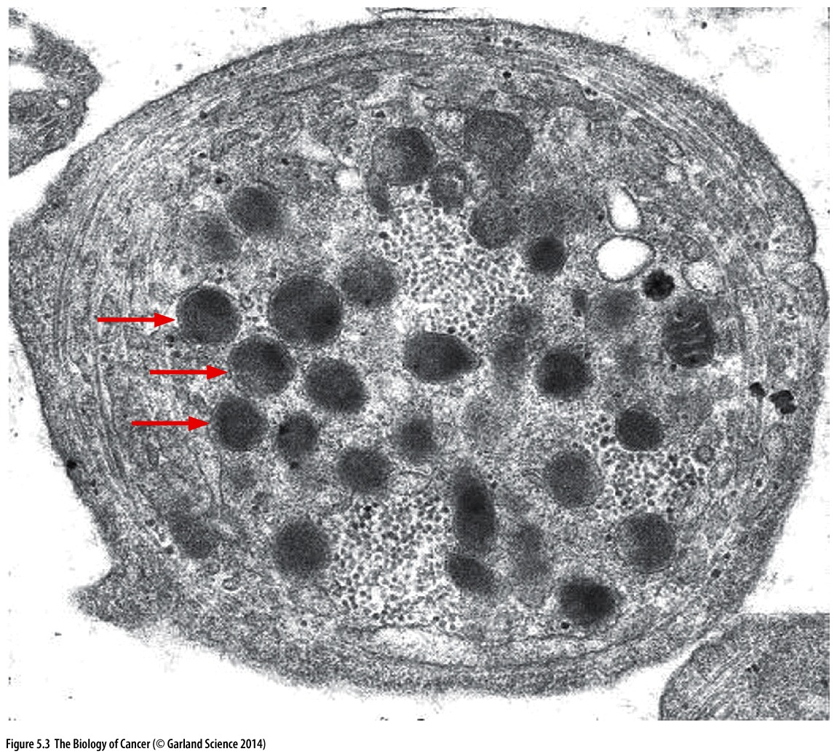
Figure 5.3 Storage of PDGF by platelets
Platelets carry numerous secretory (exocytotic) vesicles termed α-granules (arrows), which contain important signaling molecules, prominent among them being several types of platelet-derived growth factor (PDGF). When platelets become activated during clot formation, these vesicles fuse with the plasma membrane, releasing previously stored growth and survival factors into the extracellular space.
Notes:
血小板中生长因子生理作用？

Slide 10
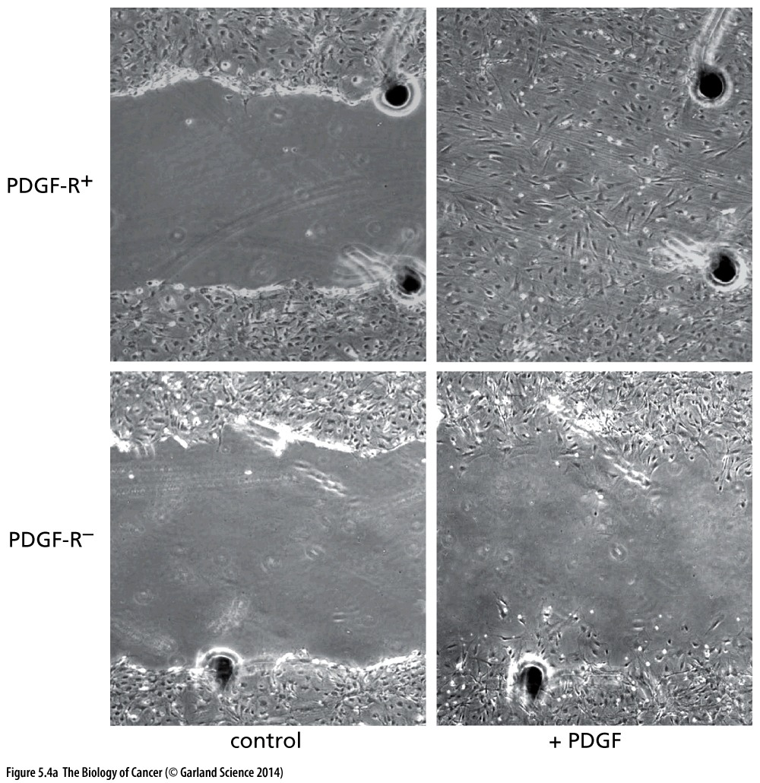
Figure 5.4 Effects of growth factors on cells
The PDGF released by platelets upon clotting is a potent attractant and mitogen for fibroblasts, which swarm into a wound site in order to reconstruct the tissue. In this in vitro model of wound healing, two monolayers of fibroblasts in Petri dishes have been wounded by the tip of a pipette (left two panels) and one form of PDGF (PDGF-BB) has been added to their growth medium. While large numbers of wild-type fibroblasts (top left) proliferate and migrate into the wound site within 48 hours (top right), mutant fibroblasts that have been rendered unresponsive to PDGF (through the loss of a PDGF cell surface receptor, PDGF-R; lower left) fail to do so (lower right).
Notes:
具体实验过程…

Slide 11
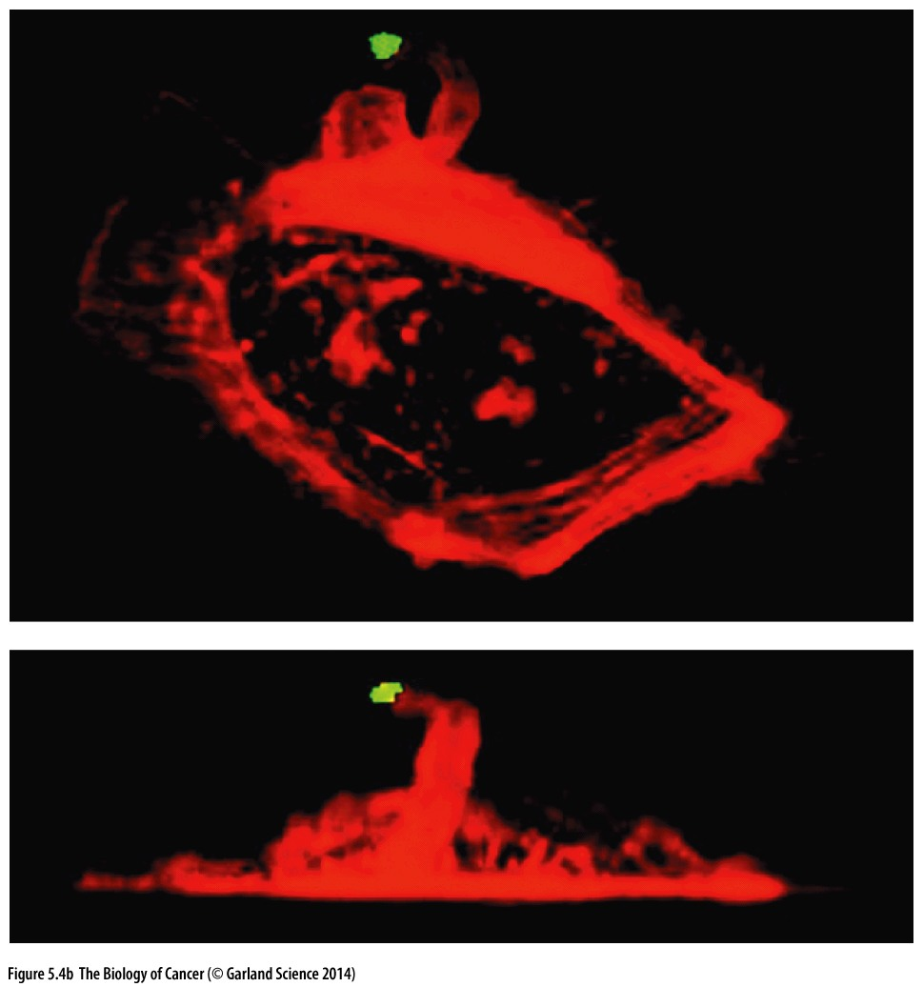
Figure 5.4 Effects of growth factors on cells
Five minutes after epidermal growth factor (EGF) that has been immobilized on a bead (green dot) is applied to a mouse mammary carcinoma cell, the cell has reorganized its actin cytoskeleton (red) and extended an arm of cytoplasm toward the growth factor

Slide 12
5.2 The Src protein functions as a tyrosine kinase

Slide 13
History about identifying Src as kinase
Biochemical experiments in 1977–1978 solved the puzzle of how Src operates. Antibodies were produced that specifically recognized and bound Src. The antibody molecules were found to become phosphorylated when they were incubated in solution with both Src and adenosine triphosphate (ATP), the universal phosphate donor of the cell.
Src: Rous Sarcoma virus oncogene
Ras: Rat sarcoma virus oncogene
Notes:
科学发现的历史指引着未来发现的道路……

Slide 14
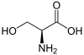
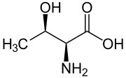
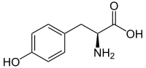
Kinase and substrate
SRC was the first cellular oncoprotein to be studied and therefore had the prospect of giving cancer researchers their first view of the biochemical mechanisms of cell transformation.
SRC is a polypeptide chain of 533 amino acid residues and had a mass of almost precisely 60 kilodaltons (kD).
Kinase is an enzyme that removes a high-energy phosphate group from ATP and transfers it to a suitable protein substrate.
Kinase substrate amino acid: Serine(丝氨酸), Threonine(苏氨酸) and Tyrosine(酪氨酸)
Serine
Threonine
Tyrosine

Slide 15
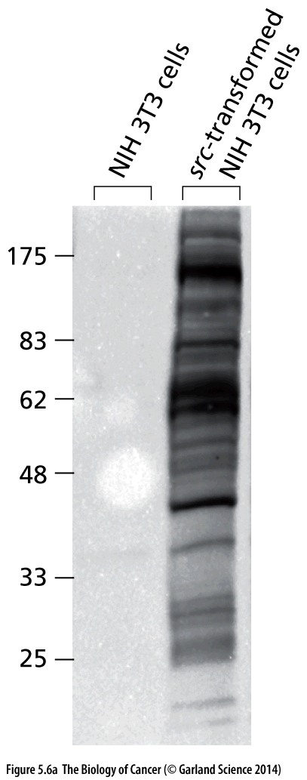
Figure 5.6 Actions of protein kinases
This autoradiograph of proteins resolved by gel electrophoresis illustrates the fact that the phosphorylation state of a number of distinct protein species within a cell can be altered by the actions of the Src kinase expressed in cells by Rous sarcoma virus. This immunoblot analysis, using an anti-phosphotyrosine antibody, specifically detects proteins that carry phosphotyrosine residues, the known products of Src kinase action (see Figure 5.7).
Notes:
Western blot

Slide 16
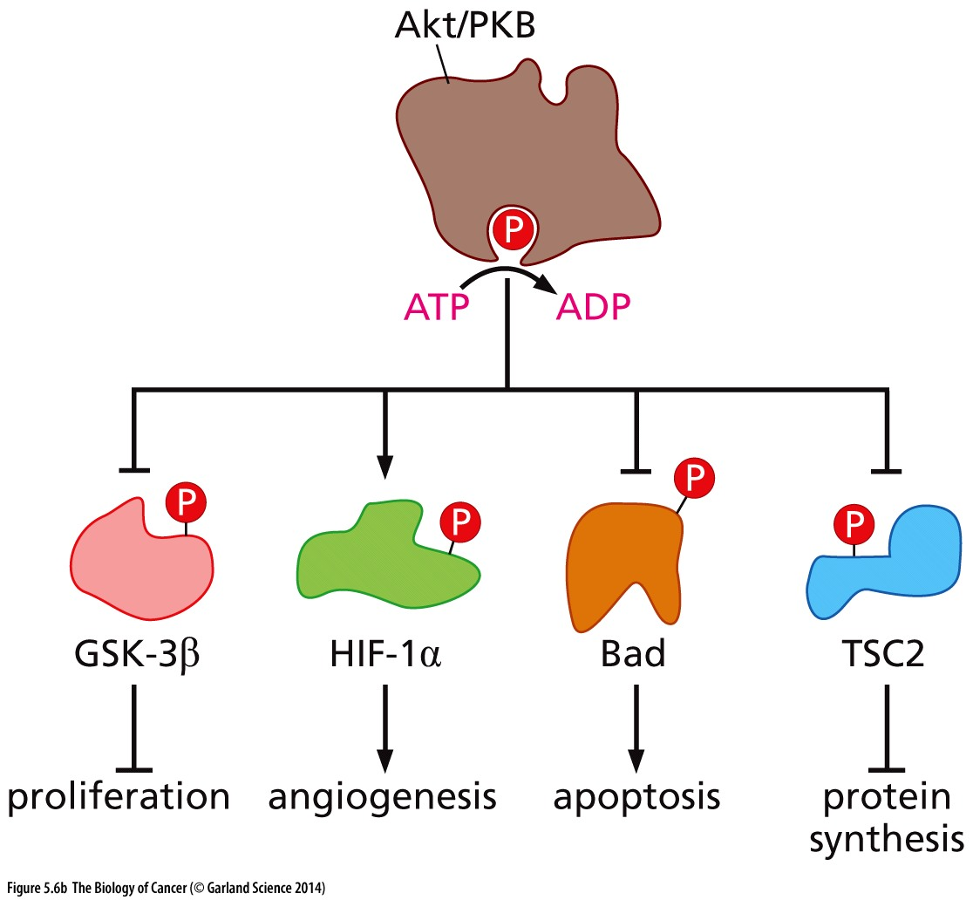
Figure 5.6 Actions of protein kinases
The pleiotropic actions of a protein kinase usually derive from its ability to phosphorylate and thereby modify the functional state of a number of distinct substrate proteins. Illustrated here are the actions of the Akt/PKB kinase, a serine/threonine kinase that can influence a wide variety of biological processes through phosphorylation of the indicated major control proteins.

Slide 17
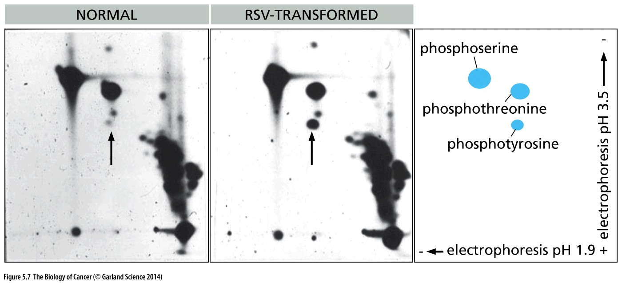
Figure 5.7 Substrate specificity of the Src kinase
In the images shown, electrophoresis was performed toward the cathode at pH 1.9 (right to left) and pH 3.5 (bottom to top). The right panel shows the expected locations of these three phosphoamino acids following electrophoresis. In normal chicken embryo fibroblasts, phosphoserine and phosphothreonine are present in abundance, while almost no phosphotyrosine is evident (arrow). However, in src-transformed CEFs, the level of phosphotyrosine (arrow) rises dramatically. Unrelated phosphorylated compounds and inorganic phosphate are seen at the lower right of each electrophoresis.
Notes:
如何检测src的底物？

Slide 18
5.3 The EGF receptor functions as a tyrosine kinase
The ErbB family of proteins contains four receptor tyrosine kinases, structurally related to the epidermal growth factor receptor (EGFR), its first discovered member. In humans, the family includes Her1 (EGFR, ErbB1), Her2 (Neu, ErbB2), Her3 (ErbB3), and Her4 (ErbB4).
Her: Human EGF receptor
Notes:
Src作为一个引子，现在转移到本次课的主角: EGFR，回顾一下EGFR是什么… Stanley Cohen 50年代发现EGF

Slide 19
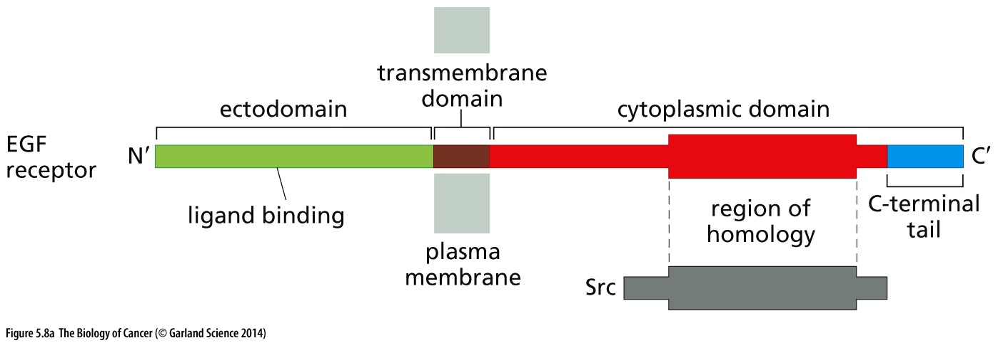
Figure 5.8 Structure of the EGF receptor
The receptor for epidermal growth factor (EGF-R) is a complex protein with an extracellular domain (ectodomain, green), a transmembrane domain that threads its way through the plasma membrane (brown), and a cytoplasmic domain (red, blue). The ligand-binding domain is responsible for binding EGF.

Slide 20
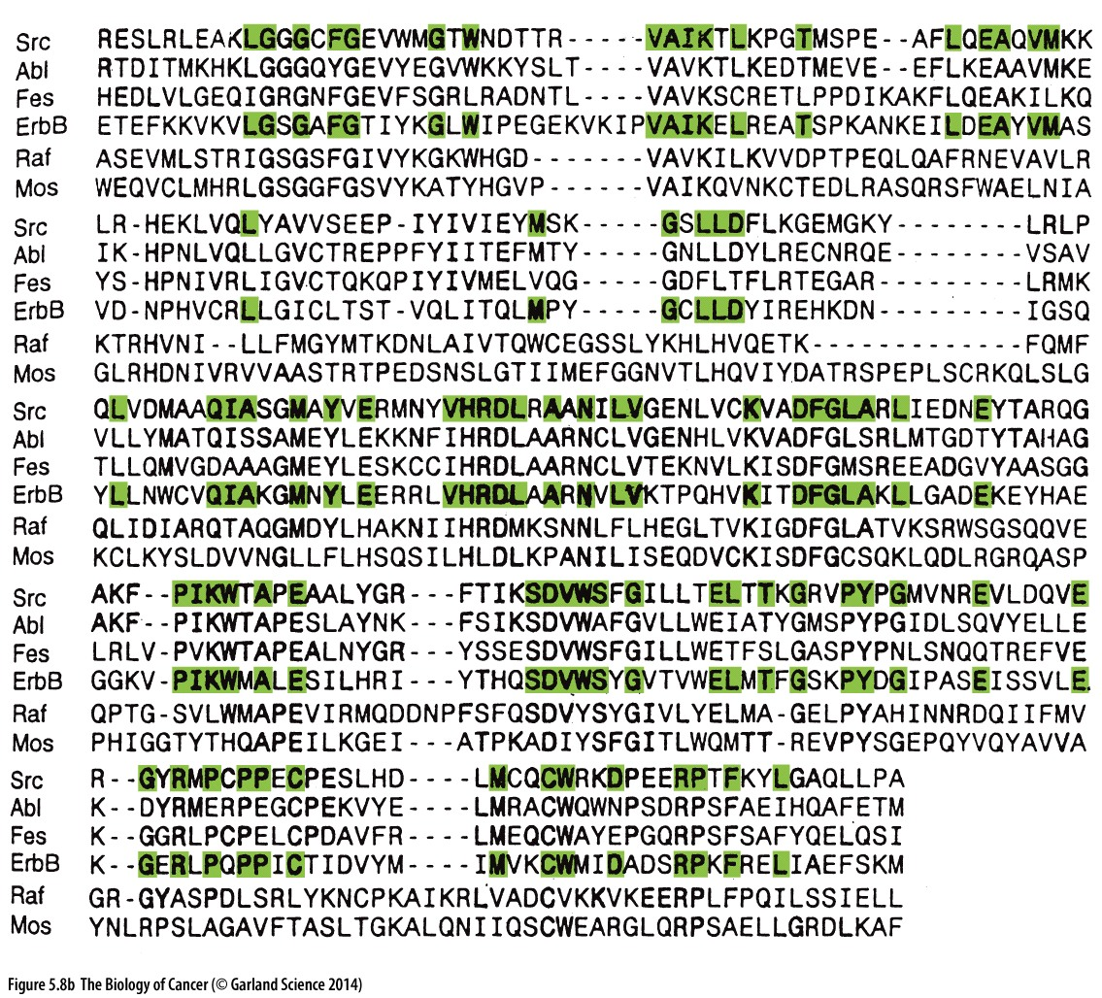
Comparison of the amino acid sequences of the cytoplasmic domains of the EGF-R (labeled “ErbB” here) and Src revealed areas of sequence identity (green). Yet other viral oncoproteins, such as Abl and Fes, some of whose sequences are also shown here, were found to share some sequence similarity with these two. The viral oncoproteins specified by the raf and mos oncogenes, which function as serine/threonine kinases, are seen to be more distantly related, sharing even fewer sequences with Src and the EGF-R. The dashes indicate amino acid residues that are missing in one protein but are present in one or more of its homologs.

Slide 21
Since these initial analyses of the EGF receptor structure, a large number of other, similarly structured receptors have been characterized (Figure 5.9).

Slide 22
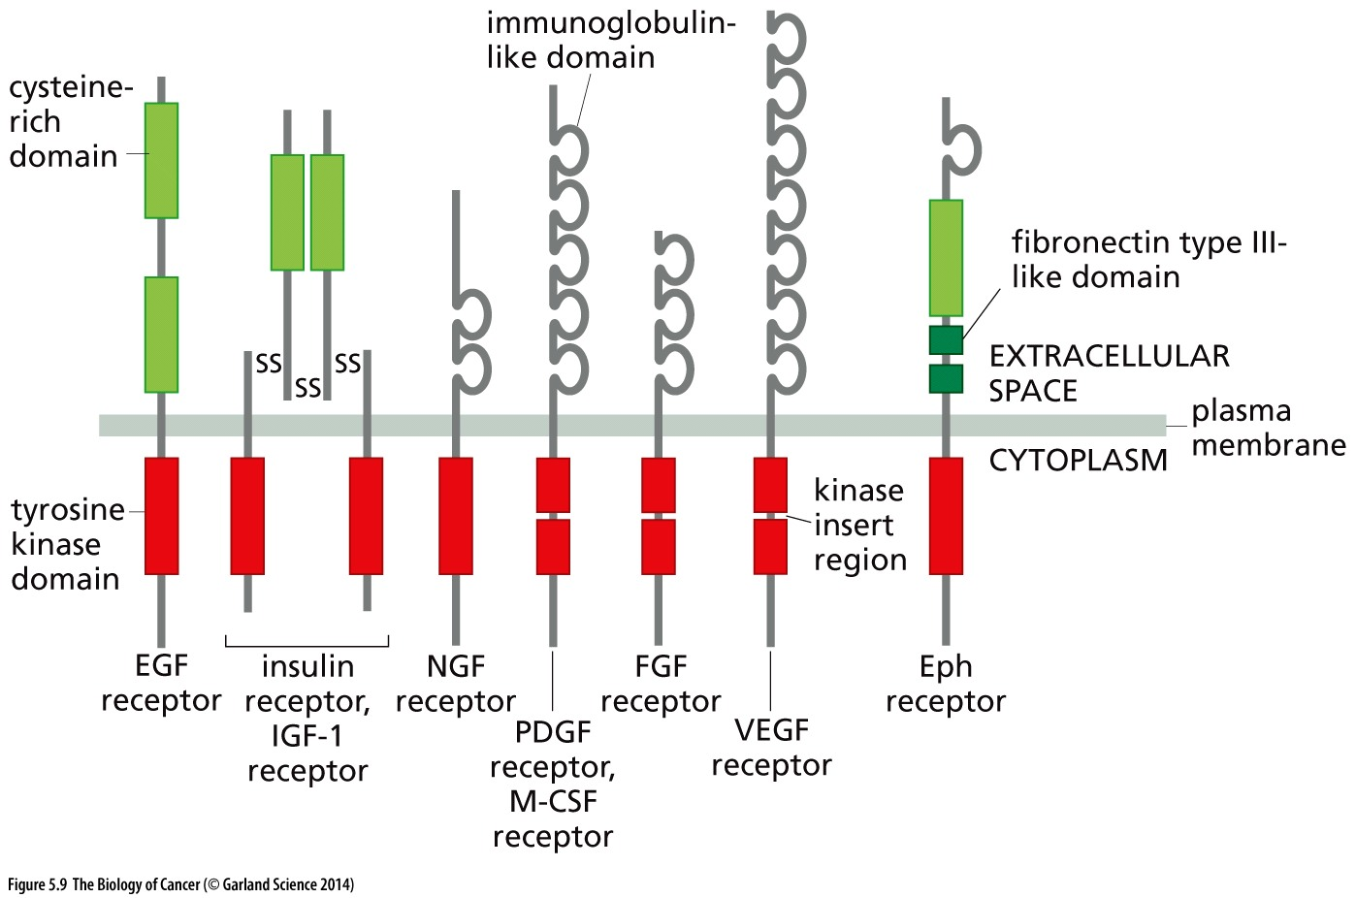
Figure 5.9 Structure of tyrosine kinase receptors
These tyrosine kinase receptors (RTKs) can be placed into distinct families, depending on the details of their structure. Representatives of most of these families are shown here. All have in common quite similar cytoplasmic tyrosine kinase domains (red), although in some cases (e.g., the PDGF receptor) these domains are interrupted by small “insert” regions. The RTK ectodomains (which protrude into the extracellular space, green, gray) have highly variable structures, reflecting the fact that they recognize and bind a wide variety of extracellular ligands.
Notes:
RTK是非常好的肿瘤治疗药物靶点，常见RTK抑制剂有抗体，小分子

Slide 23
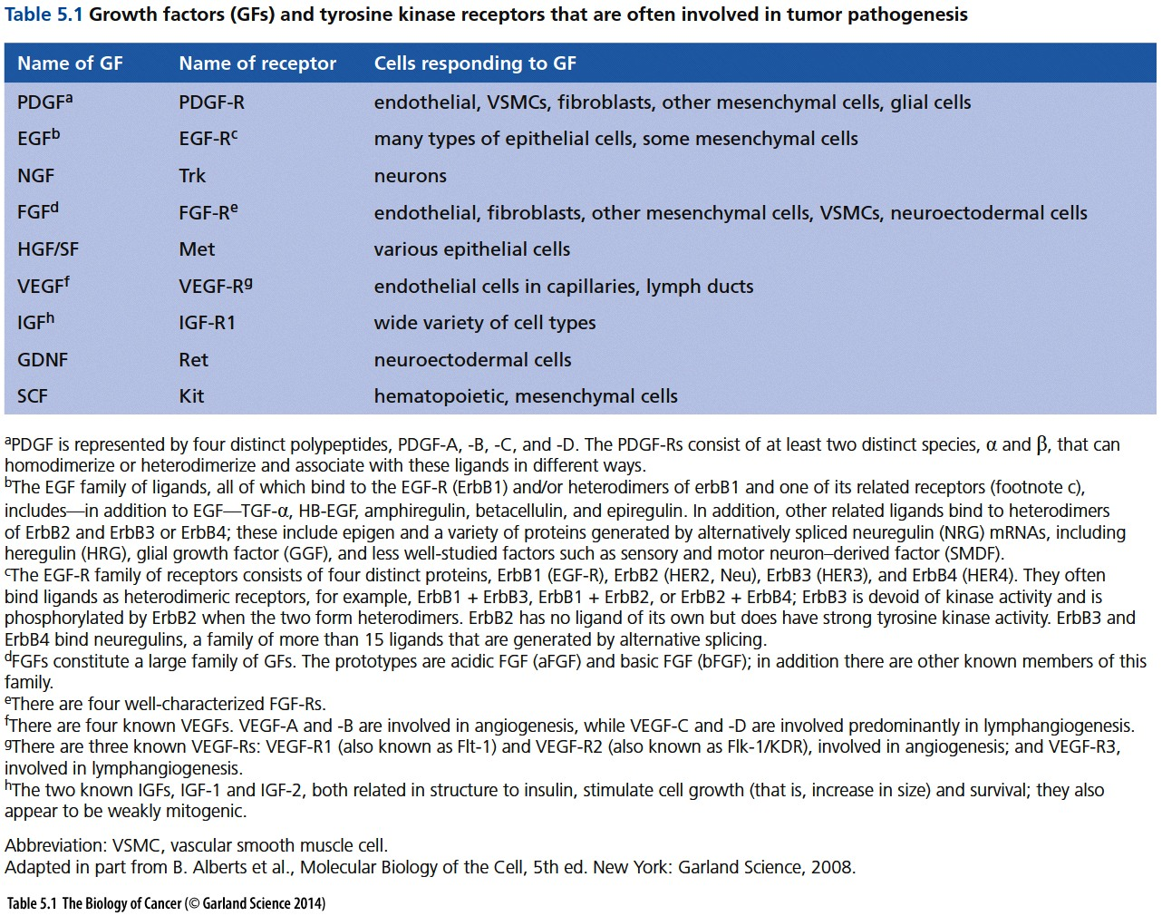

Slide 24
EGFR and erbB
A real bombshell(爆炸性事件) fell in 1984 when the sequence of the EGF receptor was recognized to be closely related to the sequence of a known oncoprotein specified by the erbB oncogene. This oncogene had been discovered originally in the genome of avian(鸟类的) erythroblastosis virus (AEV), a transforming retrovirus that rapidly induces a leukemia of the red blood cell precursors (an erythroleukemia). In one stroke, two areas of cell biology were united. A protein used by the cell to sense the presence of a growth factor in its surroundings had been appropriated (in its avian form) and converted into a potent retrovirus-encoded oncoprotein.

Slide 25
5.4 An altered growth factor receptor can function as an oncoprotein

Slide 26
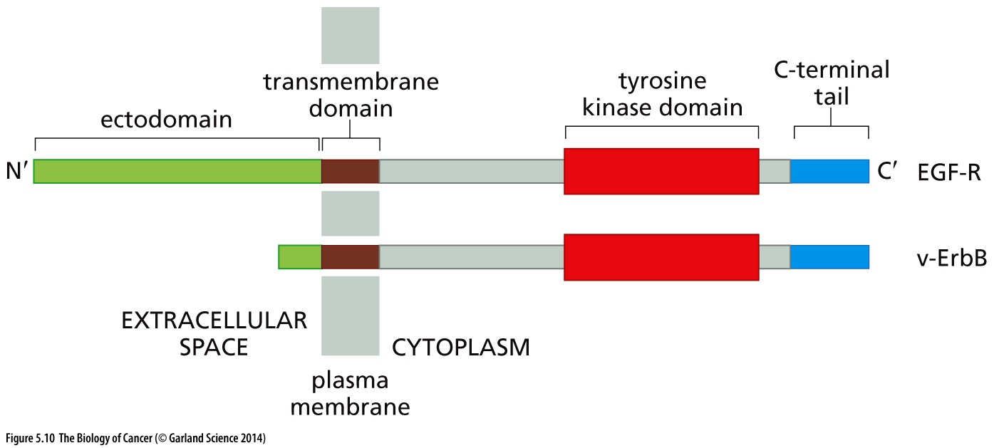
Figure 5.10 The EGF receptor and v-ErbB
The EGF receptor and the v-ErbB oncoprotein of avian erythroblastosis virus are closely related. More specifically, the v-ErbB protein is specified by an altered version of the gene encoding the chicken EGF receptor, which encodes a truncated form of EGF-R that lacks most of the normally present ectodomain (green). Such a truncated receptor can emit mitogenic signals constitutively, i.e., without stimulation by EGF ligand.

Slide 27
Normal cells had long been known to require growth factors in their culture medium in order to grow. Cancer cells, in contrast, were known to have a greatly reduced dependence on growth factors for their growth and survival. The discovery of the ErbB–EGF-R connection yielded a simple, neat explanation of this particular trait of cancer cells

Slide 28
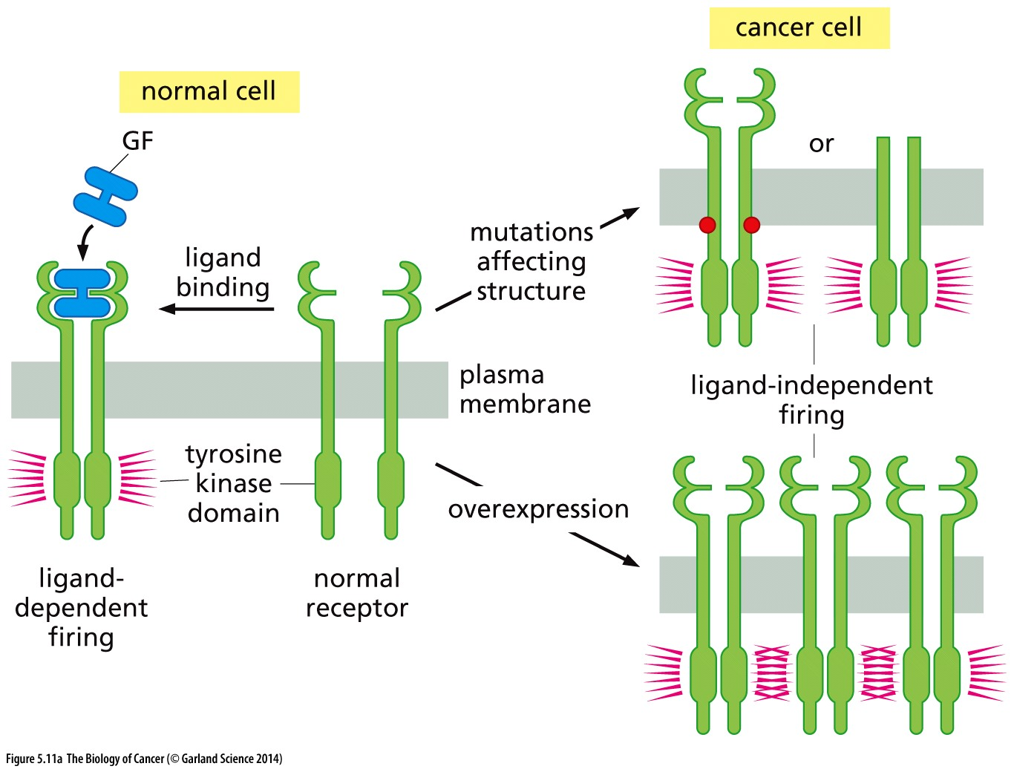
Figure 5.11 Deregulation of receptor firing
(A) Normally functioning growth factor receptors emit cytoplasmic signals in response to binding ligand. However, mutations in the genes encoding the receptor molecules (upper right) can cause subtle alterations in protein structure, such as amino acid substitutions (red dots), that cause ligand-independent firing. More drastic alterations in receptor structure, including truncation of the ectodomain, may also yield such deregulated signaling. In many human tumors, receptor proteins are overexpressed. Excessive numbers of normally structured receptor molecules can also drive ligand-independent receptor firing by causing these molecules to frequently collide and thereby spontaneously dimerize and release signals.

Slide 29
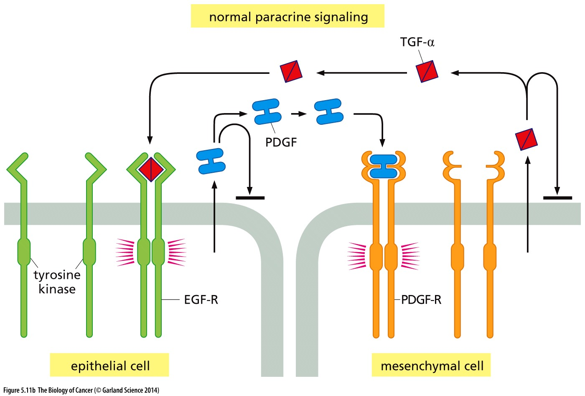
(B) In general, normal cells do not synthesize and release a growth factor ligand whose cognate receptor they also display. Shown here is the tendency of epithelial cells to make PDGF, the ligand for the PDGF-R displayed by mesenchymal cells; conversely mesenchymal cells often make TGF-α, an EGF-related ligand which binds the EGF-R displayed by epithelial cells. However, the PDGF made by an epithelial cell fails to find its cognate receptor on the surface of that cell (horizontal bar) preventing inadvertent activation of autocrine signaling.

Slide 30
Paracrine, endocrine vs autocrine signaling
Rather than a growth factor signal sent from one type of cell to another cell type located nearby (often termed paracrine signaling), or sent via the circulation from cells in one tissue in the body to others in a distant tissue (endocrine signaling), this represented an auto-stimulatory, or autocrine, signaling loop in which a cell manufactured its own mitogens (see Figure 5.11C and D). (An autocrine signaling mechanism also explains how Friend leukemia virus, another retrovirus of mice, provokes disease; see Sidebar 5.2.)

Slide 31
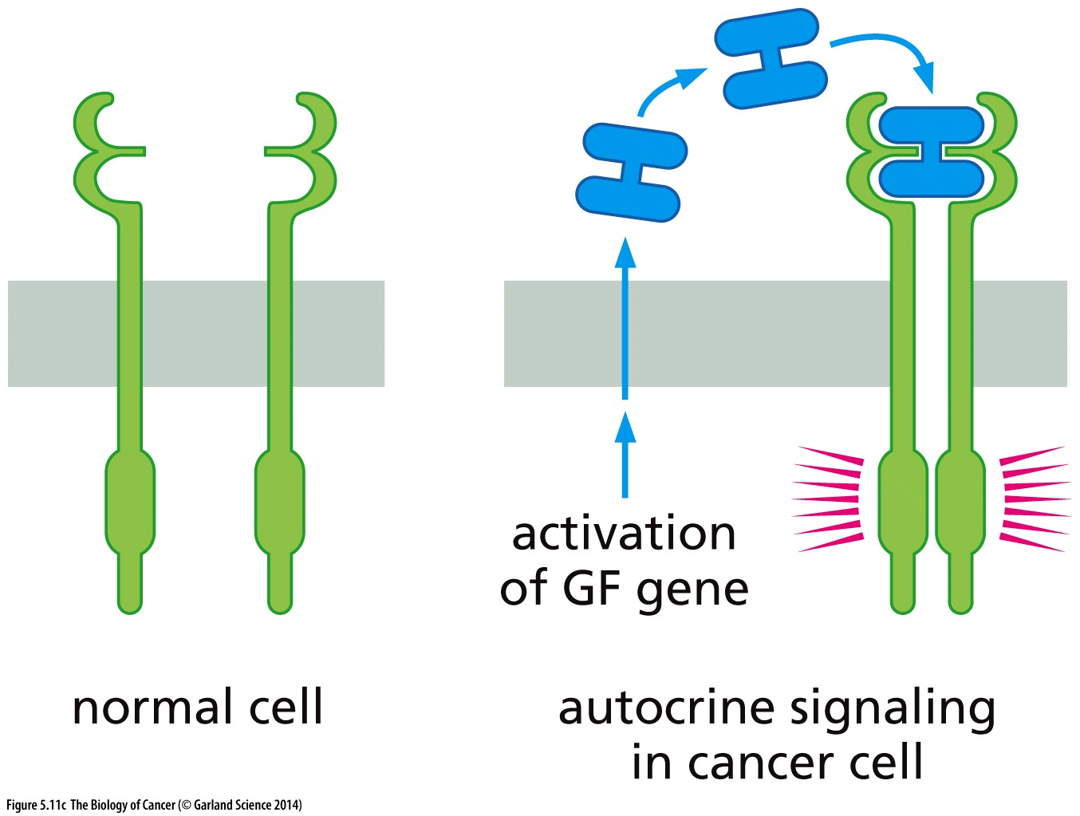
Figure 5.11 Deregulation of receptor firing
(C) In contrast, in many types of cancer, tumor cells acquire the ability to make a ligand for a growth factor receptor that they also display (right). This creates an auto-stimulatory or autocrine signaling loop.

Slide 32
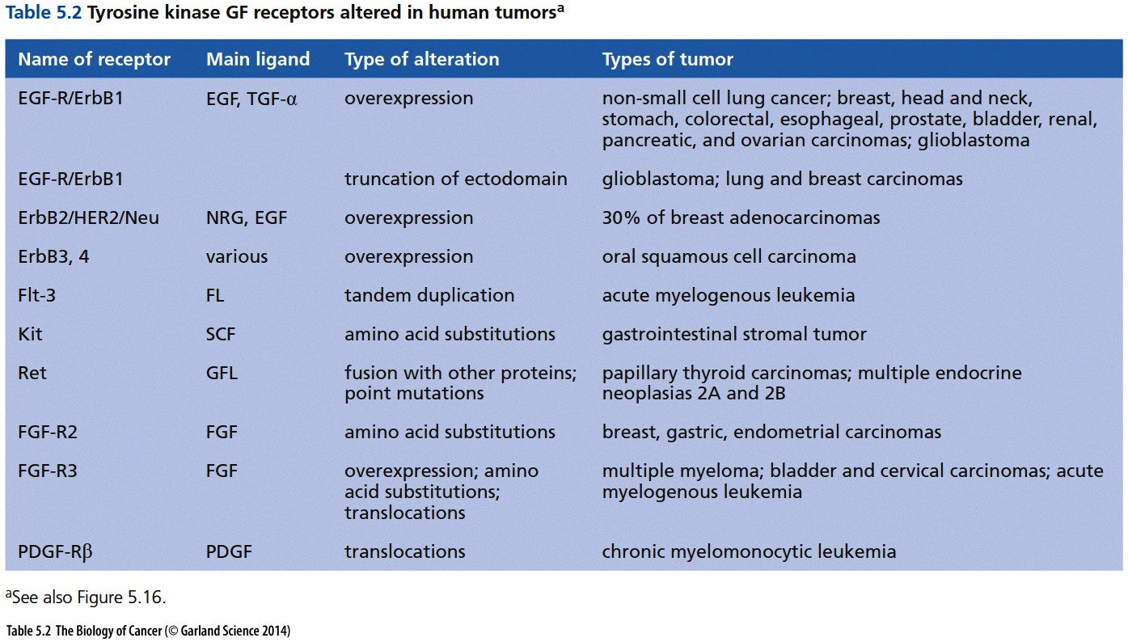
Notes:
供参考

Slide 33
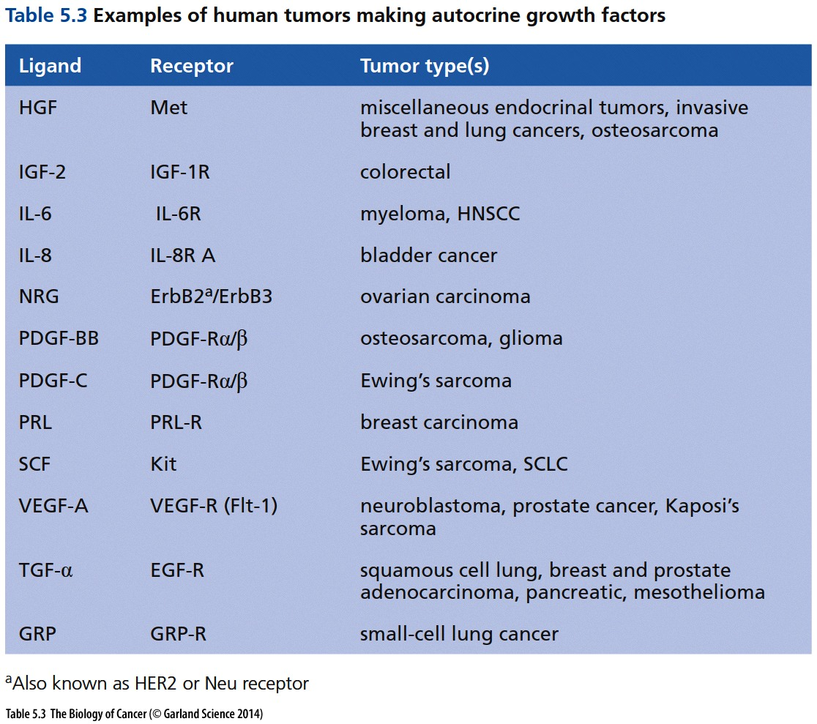
Notes:
供参考

Slide 34
PDGF and sis
In 1983, the B chain of PDGF was found to be closely related in sequence to the oncoprotein encoded by the v-sis oncogene of simian sarcoma virus. Once again, study of the oncogenes carried by rapidly transforming retroviruses paid off handsomely.
Besides growth factor receptor, growth factor can also become oncogene
EGFR
PDGF

Slide 35
Key question:
How do growth factor receptors containing tyrosine kinases (often called receptor tyrosine kinases or RTKs) succeed in transducing signals from the extracellular space into the cytoplasm of cells?

Slide 36
Experimental evidences
1. Growth factor receptors are capable of autophosphorylation
2. Growth factors were often found to be dimeric(二聚体)
3. Transmembrane proteins like the EGF and PDGF receptors have lateral mobility in the plane of the plasma membrane.

Slide 37
Receptor dimerization and transphosphorylation
In the absence of ligand, a growth factor receptor exists in a monomeric form, embedded in the plasma membrane. When presented with its growth factor ligand, which is a homodimer, a receptor molecule will bind to one of the two subunits of this ligand. Thereafter, the ligand–receptor complex will wander around the plasma membrane until it encounters another receptor molecule, to which the second, still-unengaged subunit of the ligand will bind. The result is a cross-linking of the two receptor molecules achieved by the dimeric ligand that forms a bridge between them.
Once dimerization of the ectodomains of two receptor molecules has been achieved by ligand binding, the cytoplasmic portions are also pulled together. Now each kinase domain phosphorylates tyrosine residues present in the cytoplasmic domain of the other receptor. This bidirectional, reciprocal phosphorylation is best described as a process of transphosphorylation (see Figure 5.14).

Slide 38
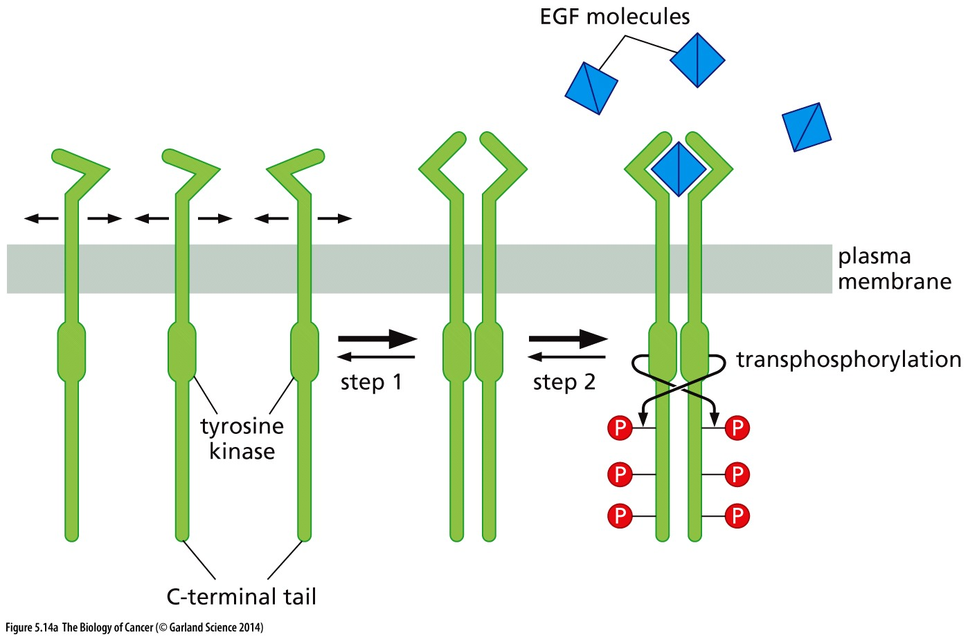
Receptor dimerization and transphosphorylation

Slide 39
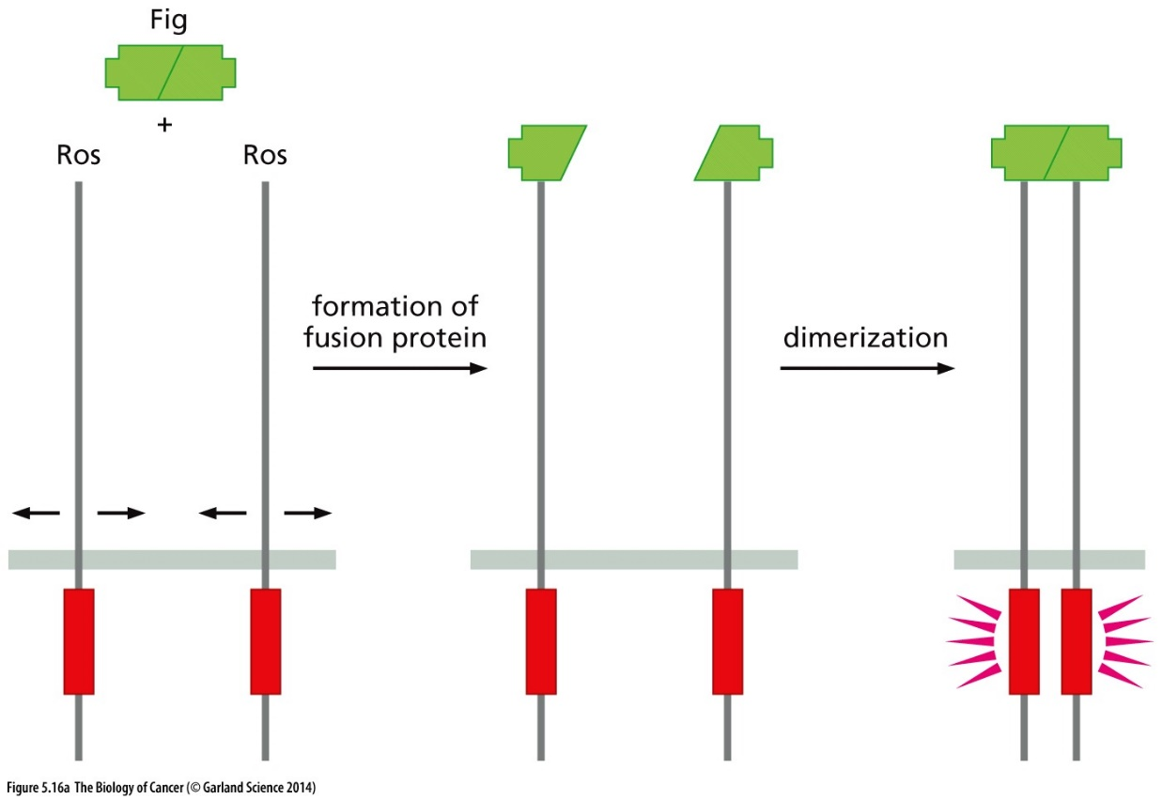
Figure 5.16 Gene fusion causing constitutively dimerized receptors
The Ros receptor like other RTKs, normally is free to move laterally in the plane of the plasma membrane and requires ligand binding for dimerization. However, in a glioblastoma, the reading frame specifying the ectodomain of the
ROS gene has become fused to the reading frame of a second, unrelated neighboring gene, termed FIG, which encodes a protein that normally dimerizes spontaneously. In the resulting fusion protein, the dimerized Fig domain pulls two Ros receptors together, resulting in constitutive, ligand-independent dimerization and signaling.

Slide 40
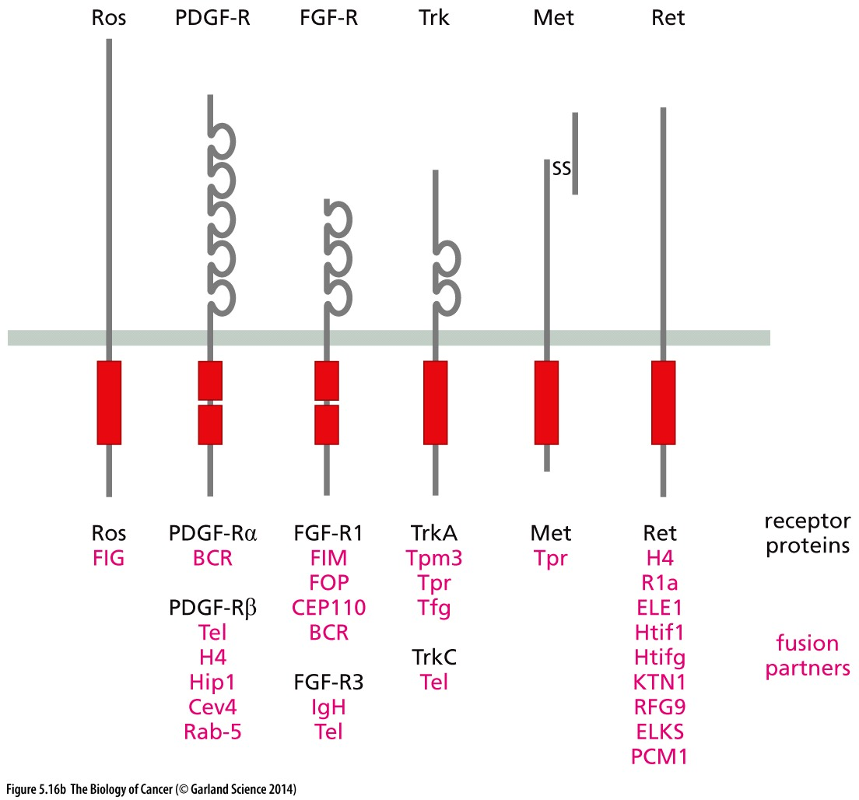
Figure 5.16 Gene fusion causing constitutively dimerized receptors
Similarly, in a diverse array of malignant tumors, receptor dimerization occurs when the genes encoding growth factor receptors (black type) become fused to unrelated genes that happen to specify proteins that normally dimerize or form higher-order oligomers (red type), dragging together pairs of receptor monomers. Listed here are a number of such mutant, fused receptors found in human tumors; in certain cases, a given receptor may be found fused to multiple alternative oligomerizing proteins.

Slide 41
Besides gene fusions, other subtle changes in receptor structure can also encourage ligand-independent firing in diverse cell types (Sidebar 5.4).
The Kit protein was originally discovered as an oncoprotein encoded by a feline(猫) sarcoma retrovirus. The kit proto-oncogene encodes a tyrosine kinase receptor whose ligand is stem cell factor (SCF), a growth factor that is important in stimulating the formation of various types of cells
v-kit: feline sarcoma viral oncogene
Notes:
c-Kit is a famous stem cell marker

Slide 42
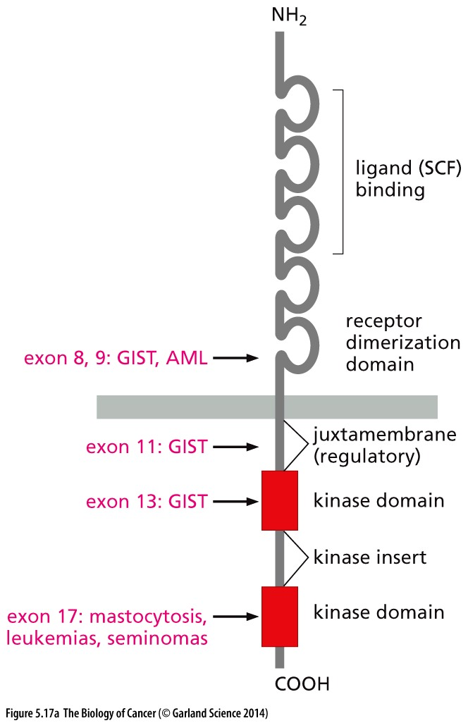
Figure 5.17 Multiple structural alterations affect Kit receptor firing
(A) As seen here, the Kit receptor may be found in a constitutively active, mutant form in a number of different types of human tumors (red type). Most of the alterations in the indicated exons involve missense point mutations in the reading frame of the Kit mRNA. GIST, gastrointestinal stromal tumor; AML, acute myelogenous leukemia.
Notes:
供参考

Slide 43
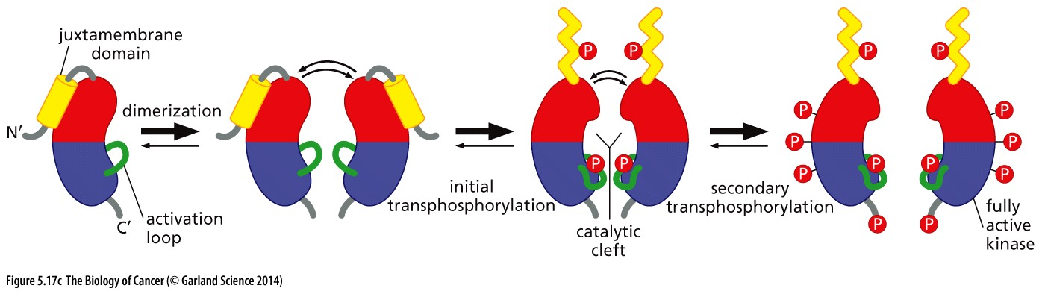
(C) The Kit receptor, which is found in mutant form in almost all gastrointestinal stromal tumors (GISTs)（胃肠道间质瘤）, often carries alterations affecting the juxtamembrane (JM) domain(近膜区). the juxtamembrane domain plays an inhibitory role in regulating the receptor

Slide 44
5.7 Yet other types of receptors enable mammalian cells to communicate with their environment

Slide 45
Receptors for cells to communicate with environment
1. Receptor tyrosine kinase;
2. Cytokine receptor: JAK-STAT signaling;
3. TGF-β receptor: TGF-β - SMAD signaling;
4. Notch receptor;
5. Patched-Smoothened: Hedgehog pathway;
6. Frizzled receptor: Wnt signaling;
7. G-protein-coupled receptor (GPCR);
8. Integrin;
9. Nuclear receptor;
**
**
**
Notes:
这些都是非常经典而且比较全面的受体信号通路，目前人类知道的重要受体信号通路都在这里。了解这些，记住一些信号通路的典型特征很有必要。

Slide 46
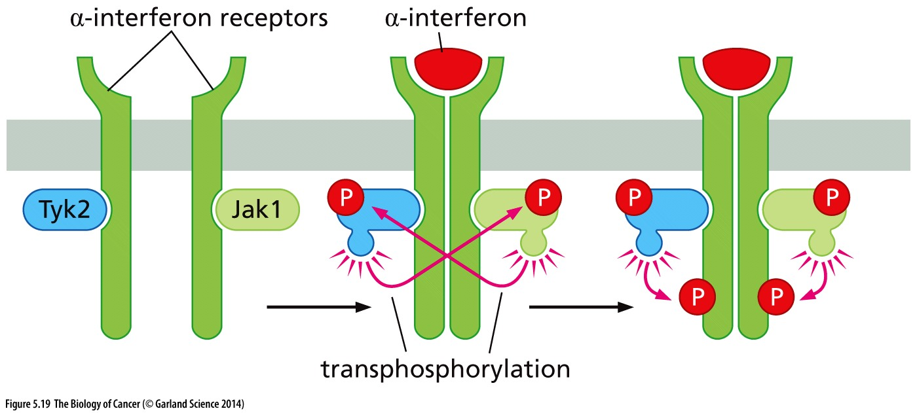
Figure 5.19 Structure of cytokine receptors
JAK-STAT signaling
The interferon receptor (IFN-R, dark green), like the receptors for erythropoietin and thrombopoietin, carries noncovalently attached tyrosine kinases (TKs) of the Jak family (in this case, Tyk2 and Jak1). Upon ligand binding, the two TKs transphosphorylate and thereby activate one another. Subsequently, they phosphorylate the C-terminal tails of the receptor subunits, placing the receptor in an actively signaling configuration, much like the receptor tyrosine kinases described in Section 5.6.
Notes:
Cytokine vs growth factor…

Slide 47
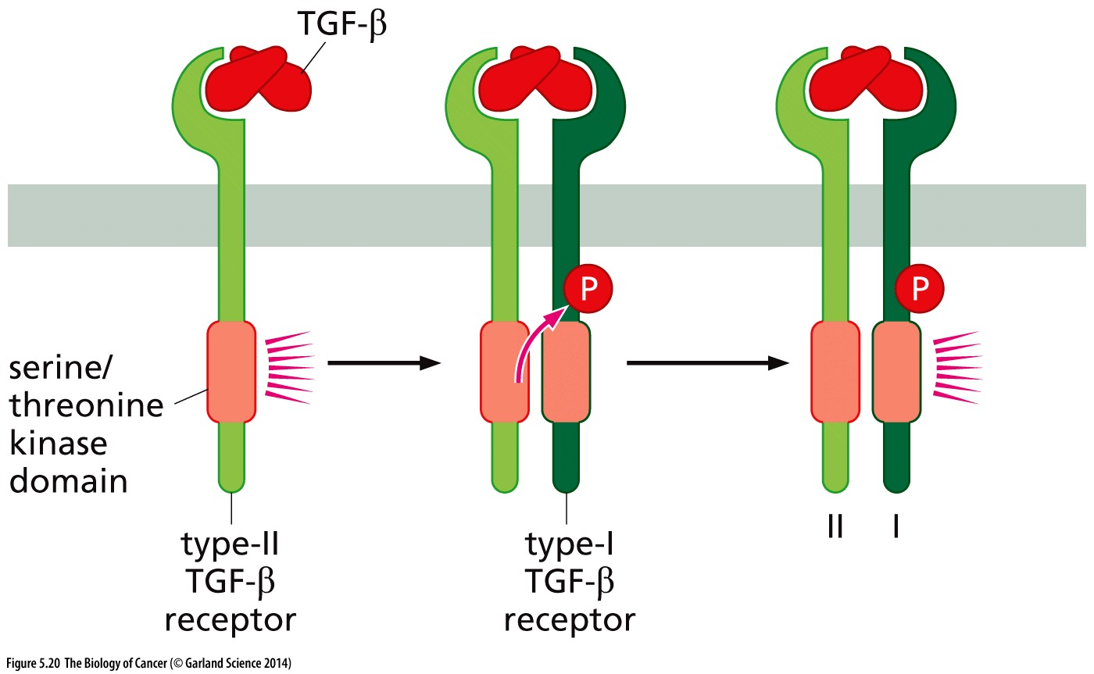
Figure 5.20 Structure of the TGF-βreceptor
TGF-β - SMAD signaling
The structure of the TGF-β receptor is superficially similar to that of tyrosine kinase receptors (RTKs), in that both types of receptors signal through cytoplasmic kinase domains. However, the kinase domains of TGF-β receptors specifically phosphorylate serine and threonine, rather than tyrosine residues.
Transforming growth factor beta :TGF-β
Notes:
TGF-β的命名是根据这种细胞因子能使正常的成纤维细胞的表型发生转化，即在表皮生长因子（EGF）同时存在的条件下，改变成纤维细胞贴壁生长特性而获得在琼脂中生长的能力，并失去生长中密度依赖的抑制作用。

Slide 48
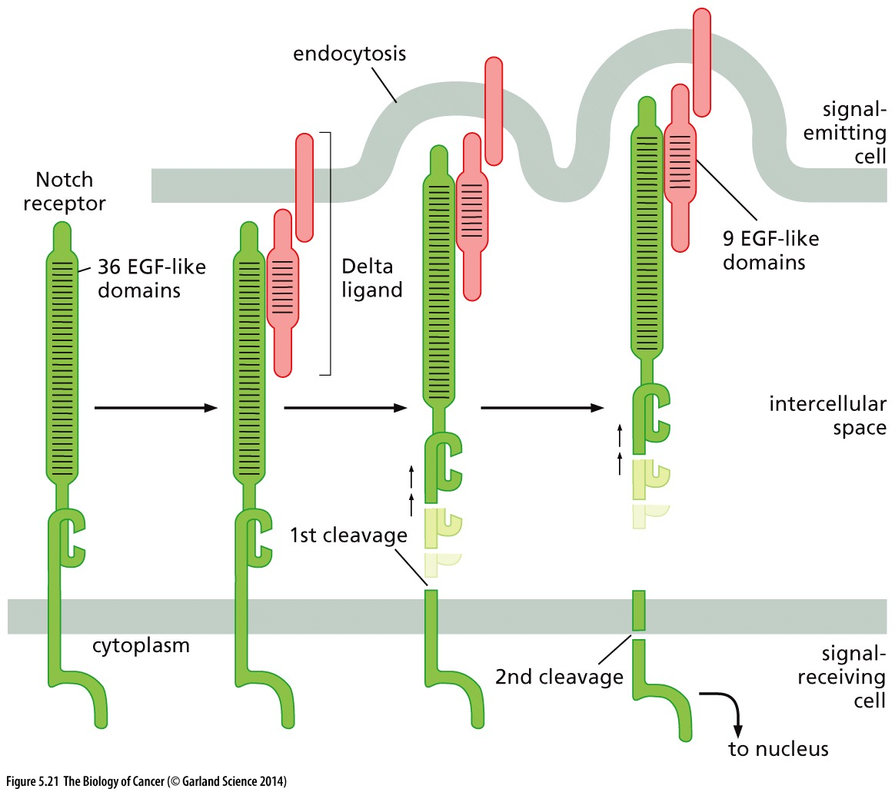
Figure 5.21 Structure of the Notch receptor
The Notch receptor (green) appears to embody a very primitive type of signaling. It is composed of two portions that are associated via noncovalent interactions. After it has bound a ligand (e.g., NotchL or, as shown here, Delta, pink) that is being displayed on the surface of an adjacent cell, the Delta ligand undergoes endocytosis into the ligand-presenting cell, which triggers two successive proteolytic cleavages of the Notch receptor. The resulting C-terminal cytoplasmic fragment of the Notch receptor is thereby freed, allowing it to migrate to the cell nucleus, where it alters the expression of certain genes.
Notes:
发育相关信号通路

Slide 49
The Patched–Smoothened signaling system
Curiously, the Patched–Smoothened signaling system depends on a structure that was once dismissed as a vestige of our early origins as ciliated (有纤毛的) single cell eukaryotes. A primary cilium protrudes from the surfaces of many if not all mammalian cell types (see Figure 5.22B). Normally, Smoothened (Smo) and the Gli transcription factor cycle back and forth out of the primary cilium (Figure 5.22A and C). However, when a Hedgehog (Hh) ligand binds its cognate receptor, Patched, in the plasma membrane, Smoothened and Gli accumulate in the primary cilium, where Gli is converted from a transcriptional repressor into an inducer of transcription and is dispatched to the nucleus.

Slide 50
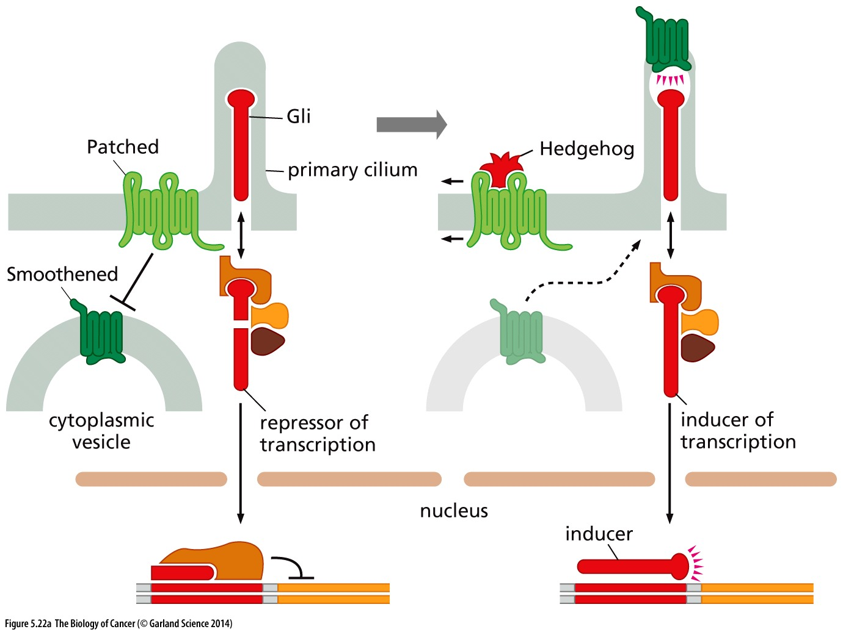
Figure 5.22 The Patched–Smoothened signaling system
The Hedgehog pathway utilizes its own, unique signaling system.
Notes:
发育相关信号通路，与部分肿瘤发生相关。该信号的特征在于受体的纤毛分布

Slide 51
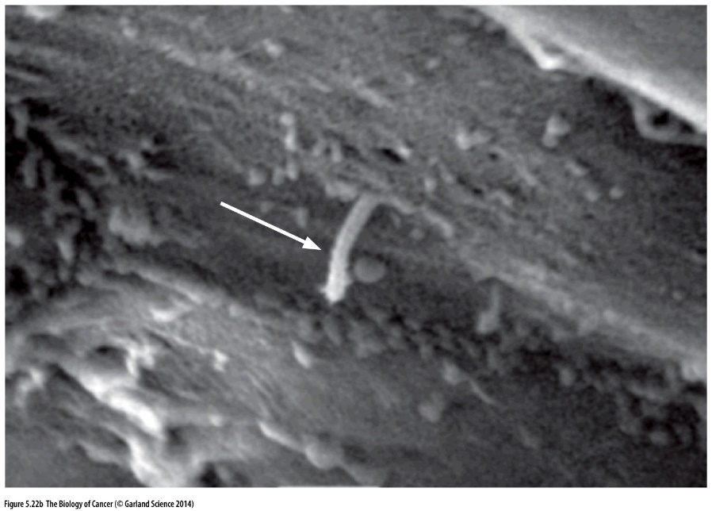
Figure 5.22 The Patched–Smoothened signaling system
The Smoothened receptor is displayed on the surface of primary cilia (white arrow), which protrude from the plasma membrane of many and perhaps all mammalian cells, as is seen here on the surface of an epithelial cell.

Slide 52
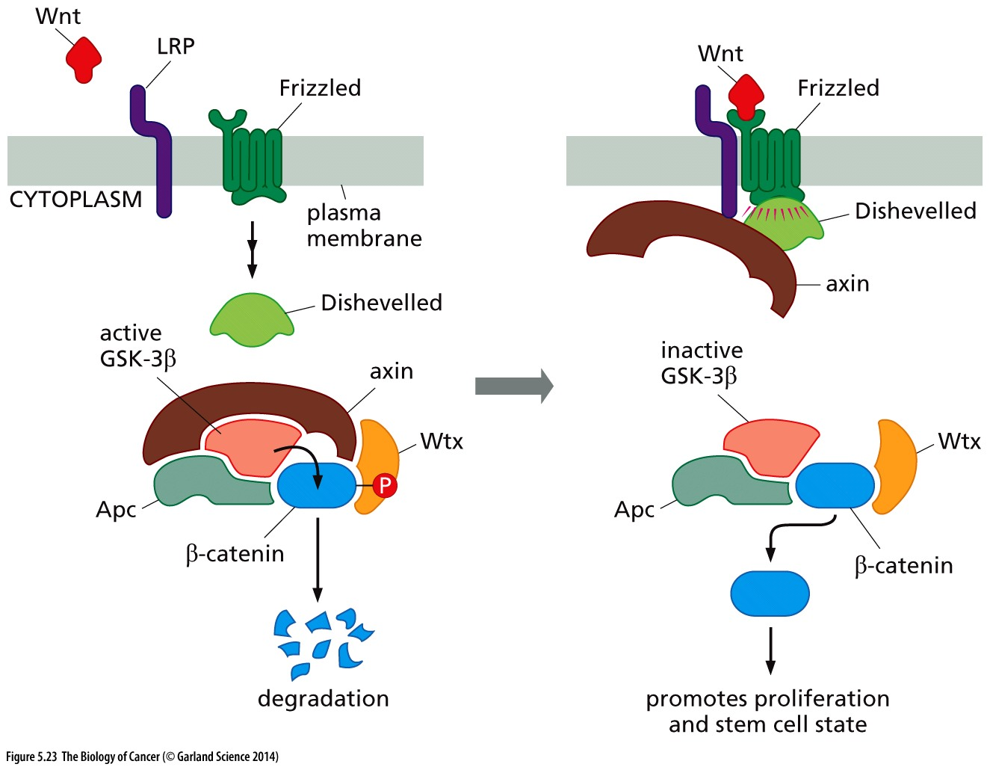
Figure 5.23 Canonical Wnt signaling via Frizzled receptors
Receptors of the Wnt proteins are members of the Frizzled (Frz) family of transmembrane proteins. In the canonical Wnt signaling pathway, and in the absence of Wnt ligand binding, a complex of axin and Apc allows glycogen synthase kinase-3β (GSK-3β) to phosphorylate β-catenin. This marks β-catenin for rapid destruction by proteolysis. However, when a Wnt ligand binds to certain Frizzled receptors and the LRP co-receptor, the resulting activated Frizzled receptor, acting via the Dishevelled protein and axin, causes inhibition of GSK-3β. This spares β-catenin, which may accumulate in the nucleus and promote cell proliferation.
Notes:
重要肿瘤pathway， APC mutation in colon cancer, βετα-catenin mutation in liver cancer;

Slide 53
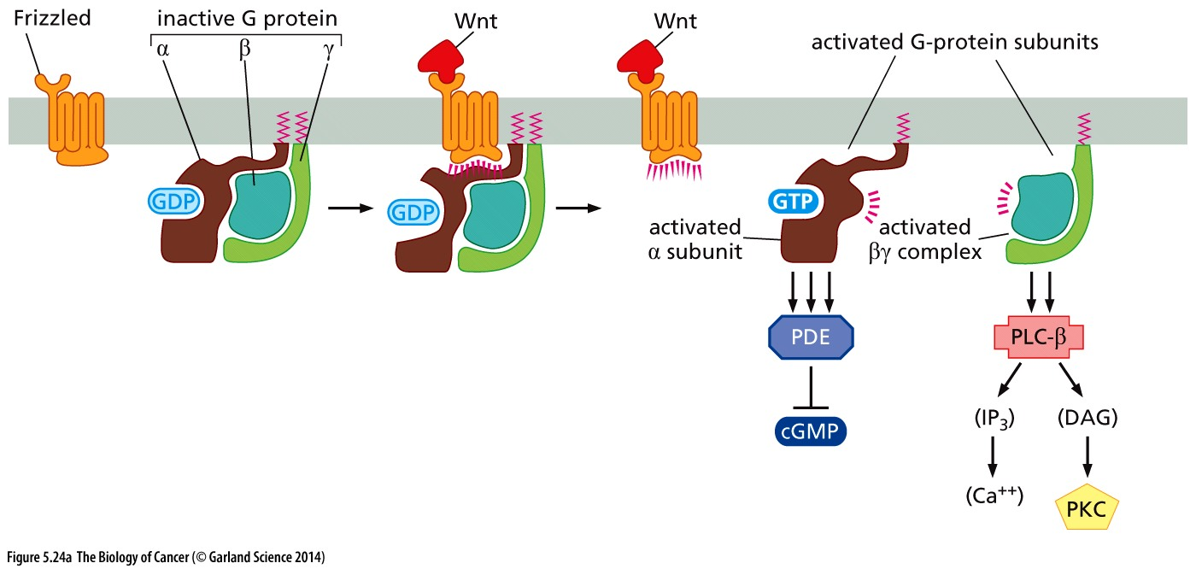
Figure 5.24 Non-canonical Wnt signaling via Frizzled receptors and GPCR
Wnts bind to a second subset of Frizzled receptors. The receptor–ligand complex then binds a heterotrimeric G-protein, which is composed of α, β, and γ subunits. The ligand-activated receptor then stimulates the α subunit of the G protein to release its GDP (guanosine diphosphate) and bind GTP (guanosine triphosphate) instead. The α subunit then dissociates from the β + γ pair. Now, the α subunit (brown) and, independently, the β + γ complex (blue, light green), can each proceed to regulate key enzymes
Notes:
供参考

Slide 54
5.8 Nuclear receptors sense the presence of low–molecular–weight lipophilic ligands
**Nuclear receptor locate in cytoplasm or nucleus, because low–molecular–weight lipophilic ligands can penetrate cell membrane;
**Nuclear receptor contain DNA-binding domain thus can function as transcription factor;
Notes:
记住这2点常识。核受体与肿瘤关系非常密切，经典的例子：雄激素受体(AR)与前列腺癌；雌激素受体(ER)与乳腺癌

Slide 55
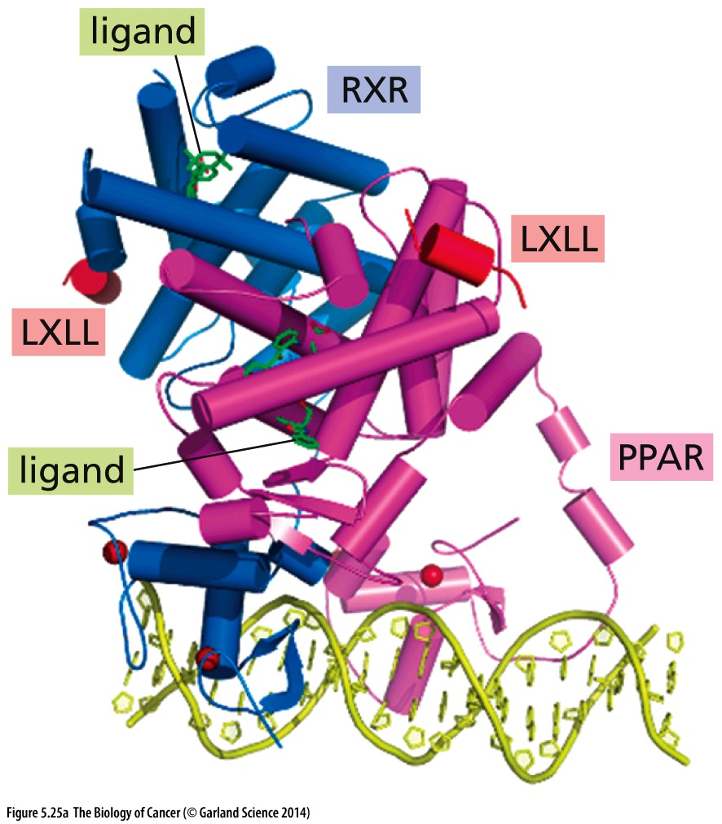
Figure 5.25 Nuclear receptors
The structure of the only nuclear receptor
complex that has been elucidated in its
entirety—the heterodimeric complex of
PPAR-γ (peroxisome proliferator-activated
receptor-γ, light purple) and the RXR
(retinoid X receptor, blue).

Slide 56
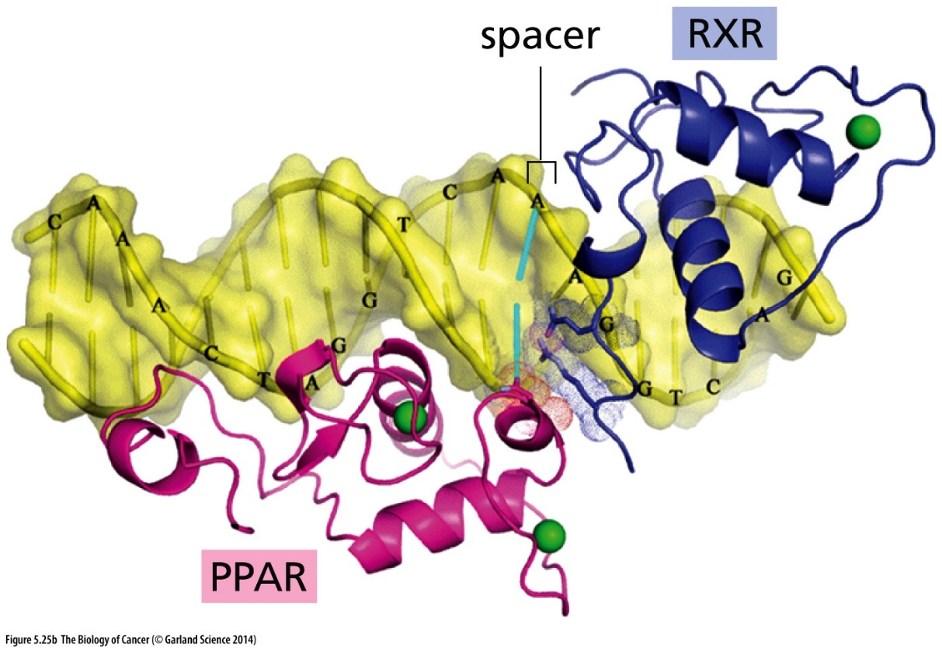
Figure 5.25 Nuclear receptors
The DNA-binding domains of the two subunits of the receptor shown in (A) are seen here in greater detail, in this case binding to two copies of the sequence AGGTCA (separated by a single base pair spacer sequence). Other nuclear receptors have paired DNA recognition sites with spacers of various lengths.

Slide 57
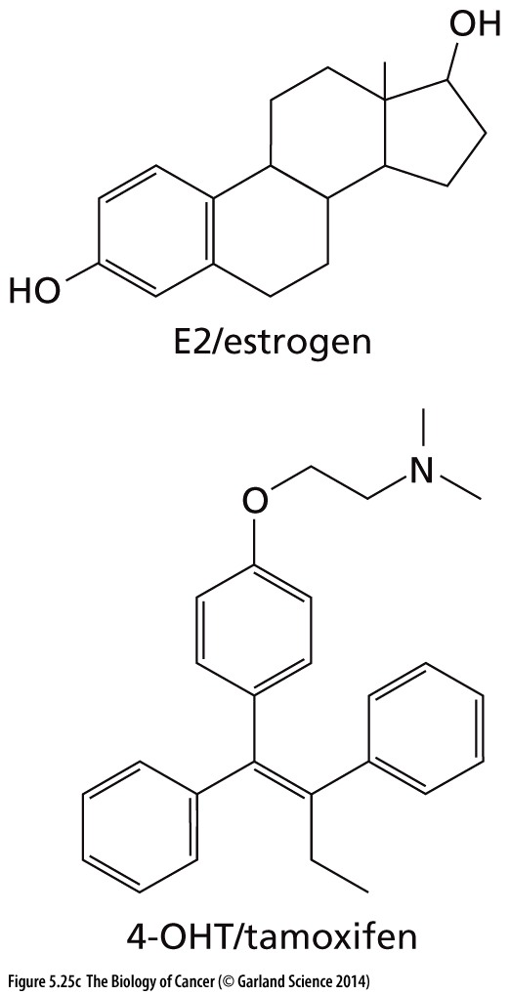
Figure 5.25 Nuclear receptors
17β-estradiol, otherwise called estrogen or simply E2, causes a conformation shift of the estrogen receptor (ER) that enables the receptor to associate physically with a co-activator, resulting in activation of transcription. Binding of pseudoligands, such as the drug 4-hydroxytamoxifen (4-OHT), causes an alternative stereochemical shift that results in the loss of contact with co-activators and the acquisition of contact with co-repressors; this explains why tamoxifen is often used therapeutically to antagonize estrogen signaling.

Slide 58
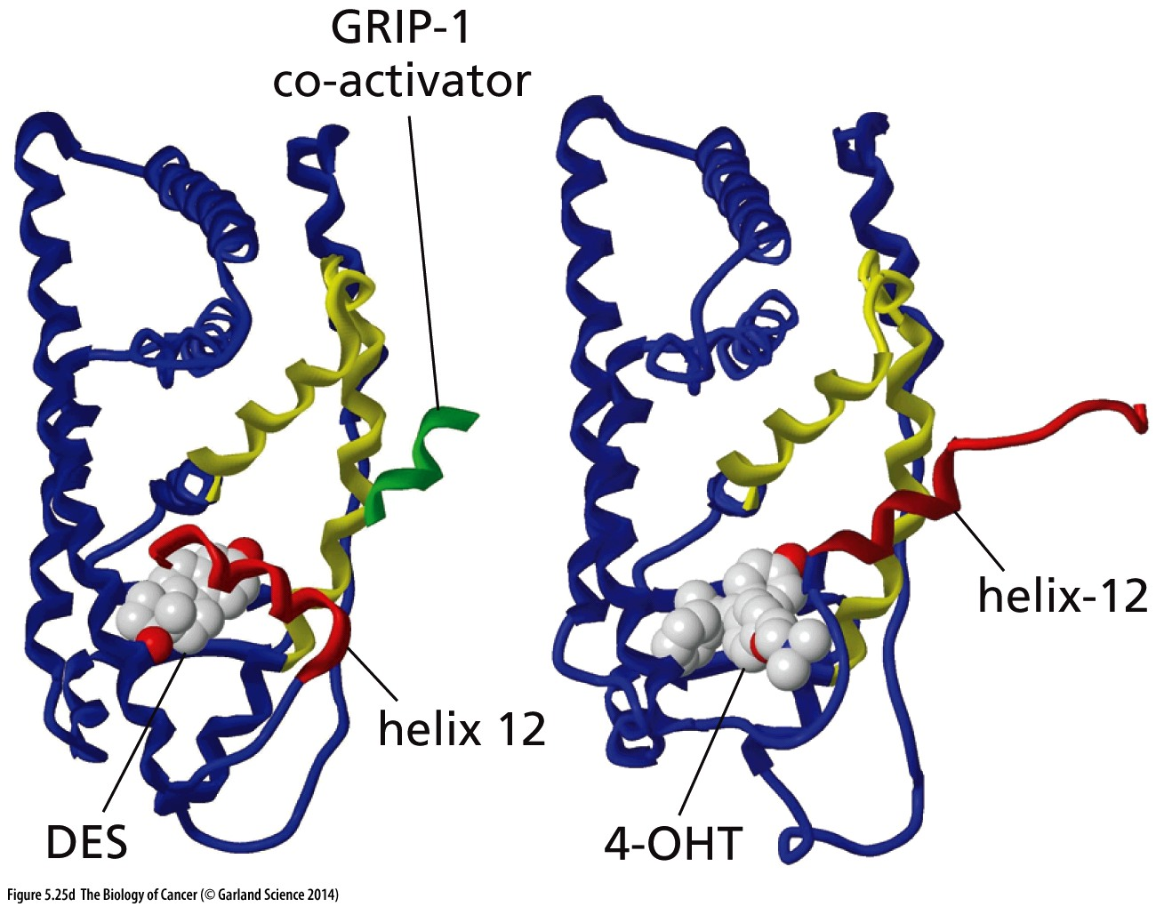
Figure 5.25 Nuclear receptors
Analysis of the effects of the E2 mimic diethylstilbestrol (DES) versus 4-OHT reveals a shift in the location of helix 12. Following DES binding, the ER is able to associate with a domain of the GRIP- 1 (glucocorticoid receptor-interacting protein-1) transcriptional co-activator. However, if the E2 antagonist（拮抗剂） 4-OHT is bound, the shift in helix 12 of the ER precludes the binding of the co-activator, blocking transcriptional activation.

Slide 59
5.9 Integrin(整合素) receptors sense association between the cell and the extracellular matrix
One of cancer cell feature: anchorage-independent growth
In the absence of anchorage, many types of normal cells will activate a version of their death program (apoptosis) that is often termed anoikis(失巢凋亡).
Notes:
整合素受体的特征：外与细胞外基质相连，内与微丝细胞骨架(actin cytoskeleton)相连

Slide 60
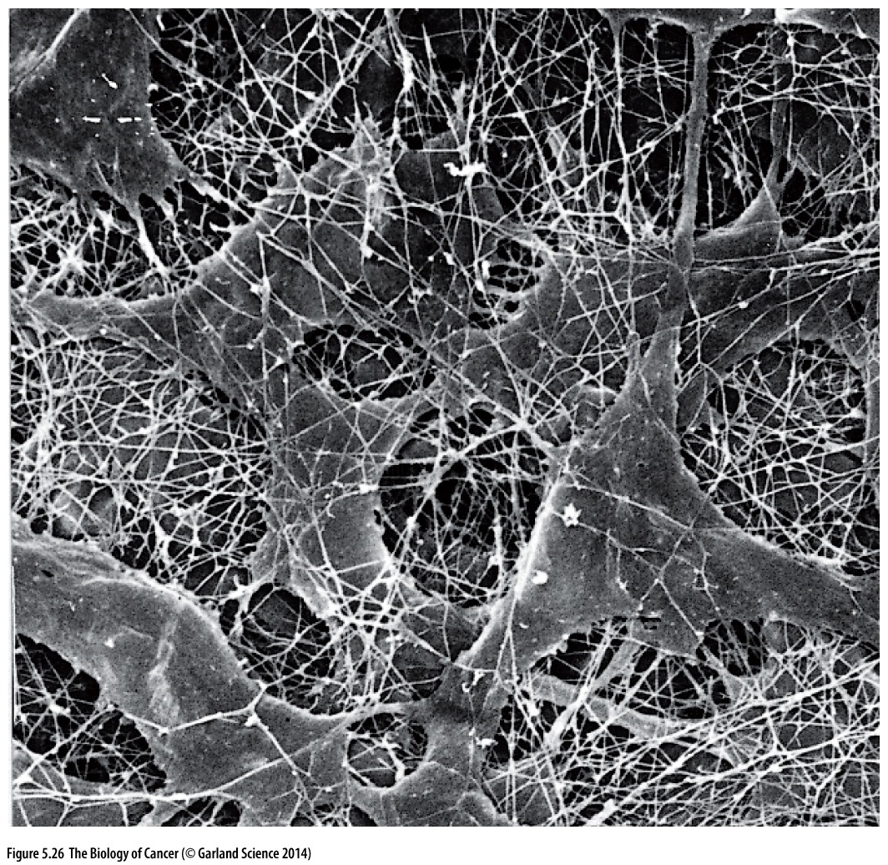
Figure 5.26 Extracellular matrix
This scanning electron micrograph illustrates fibroblasts embedded in the specialized extracellular matrix (ECM) present in the cornea（眼角膜）. Many of the components of this ECM, including glycoproteins, hyaluronan（透明质酸）, and proteoglycans, have been removed in order to highlight its major component—collagen fibers. Hence, the density of fibers in the ECM within the corresponding living tissue is actually much higher.
ECM is composed of a series of glycoproteins, including collagens, laminins, proteoglycans, and fibronectin
Notes:
细胞外基质的成分…

Slide 61
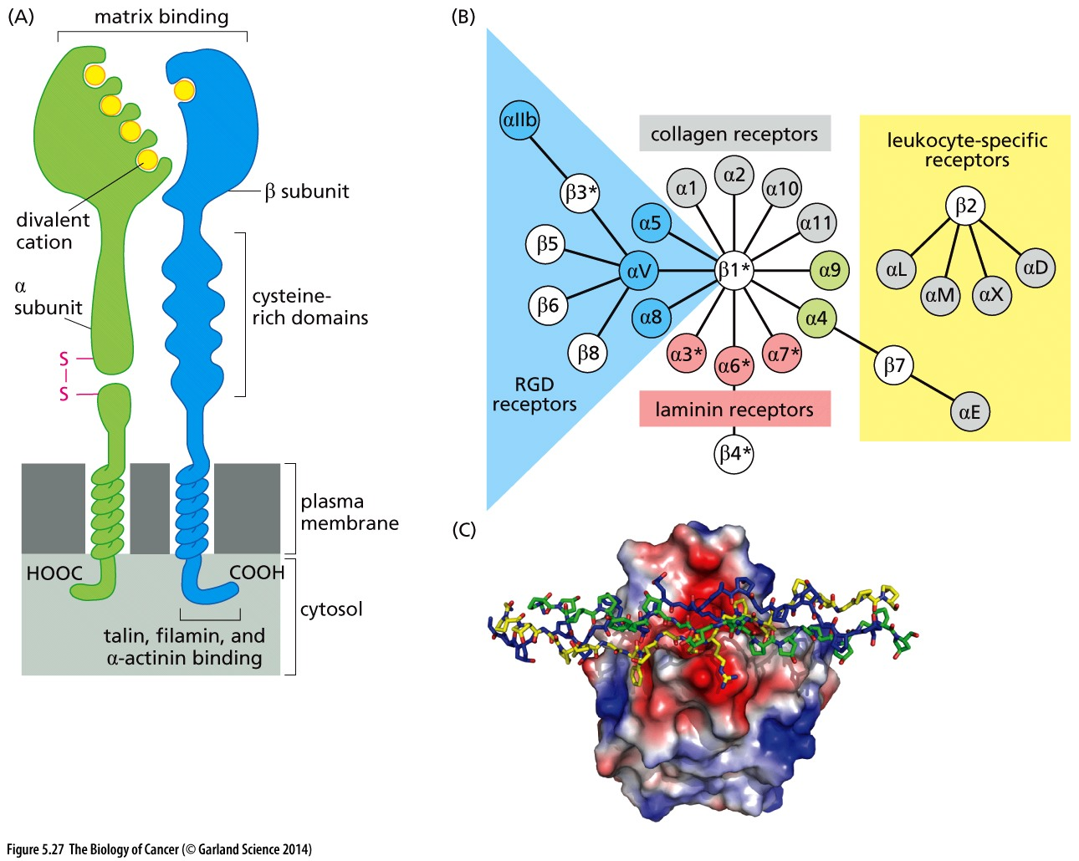
Figure 5.27 Structure of integrins
Integrin molecules function as heterodimeric cell surface receptors, each composed of an α plus a β subunit.

Slide 62
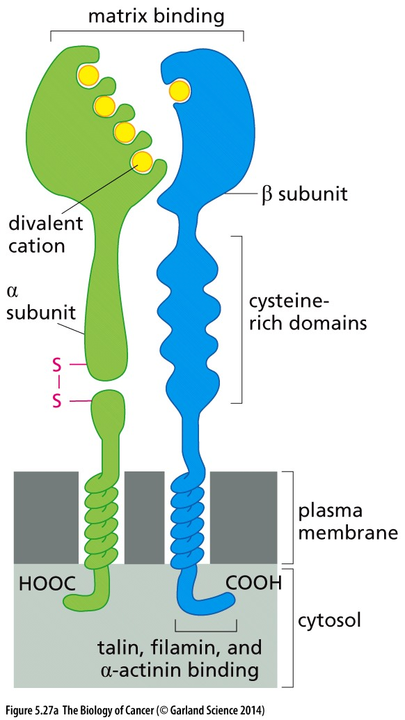
Figure 5.27 Structure of integrins
The ectodomains of these receptors bind specific components of the extracellular matrix (ECM). Divalent cations, notably magnesium（镁）, manganese（锰）, and calcium（钙）, modulate this binding in various ways. At the same time, the cytoplasmic domain is linked, via intermediary proteins, to the cytoskeleton (largely that constructed by actin fibers); in addition, the cytoplasmic domains may attract a variety of signal-transducing proteins that become activated when the ectodomain binds an ECM ligand.

Slide 63
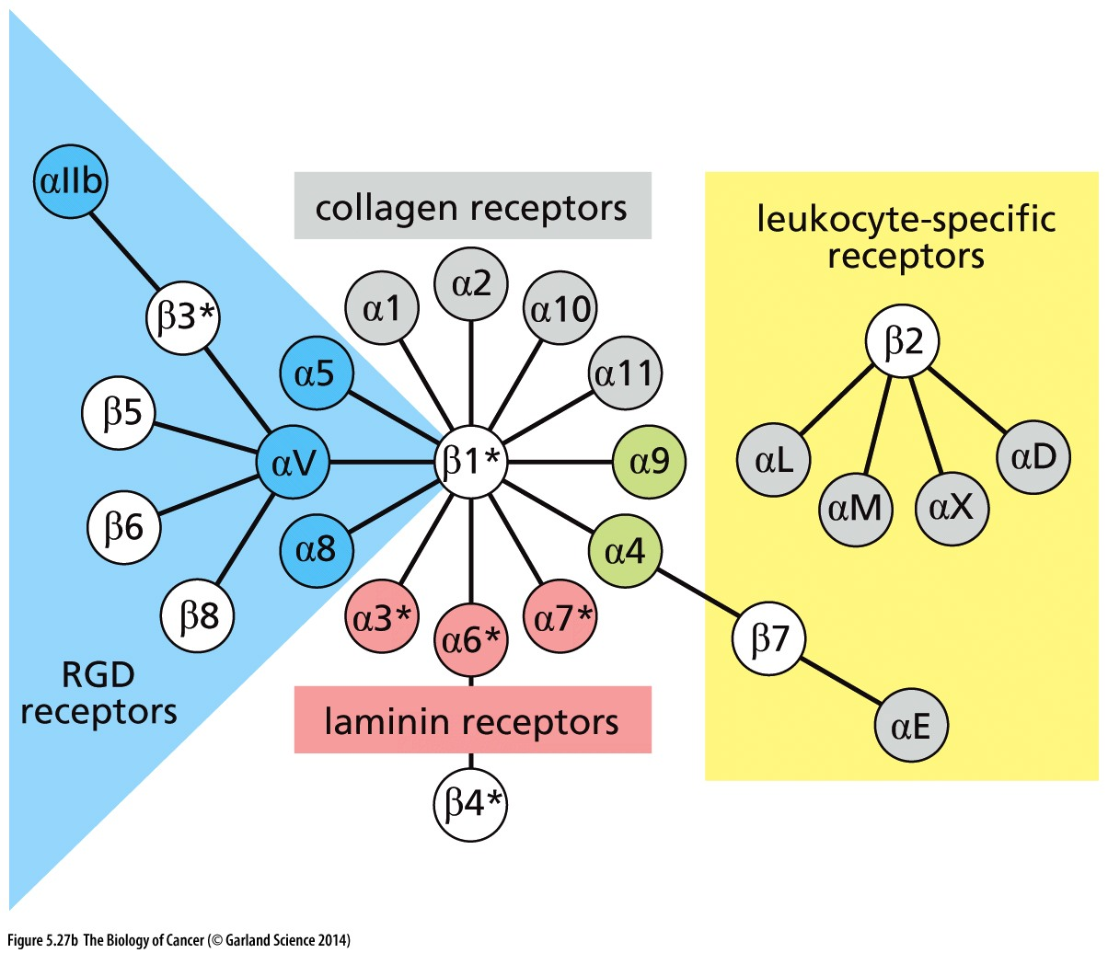
Figure 5.27 Structure of integrins
The α and β integrin subunits associate with one another as heterodimers in various specific combinations to enable the binding of a variety of ECM ligands and to transduce multiple signals into the cell.

Slide 64
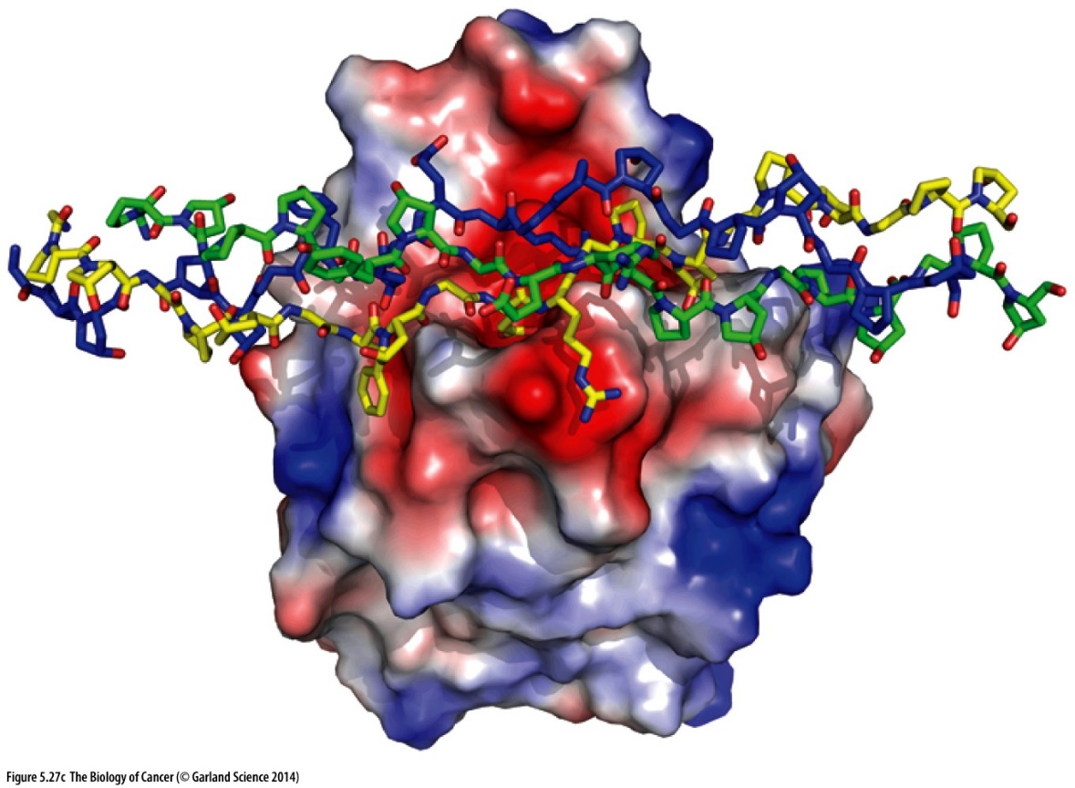
Figure 5.27 Structure of integrins
One depiction of integrin–ECM binding comes from the crystallographic analysis of the ectodomain of the α2β1 integrin interacting with collagen I, a triple helix. The red surface patches on the integrin ectodomain contain the more acidic side chains, while the blue surface patches contain basic amino acid
Notes:
结构图供参考

Slide 65
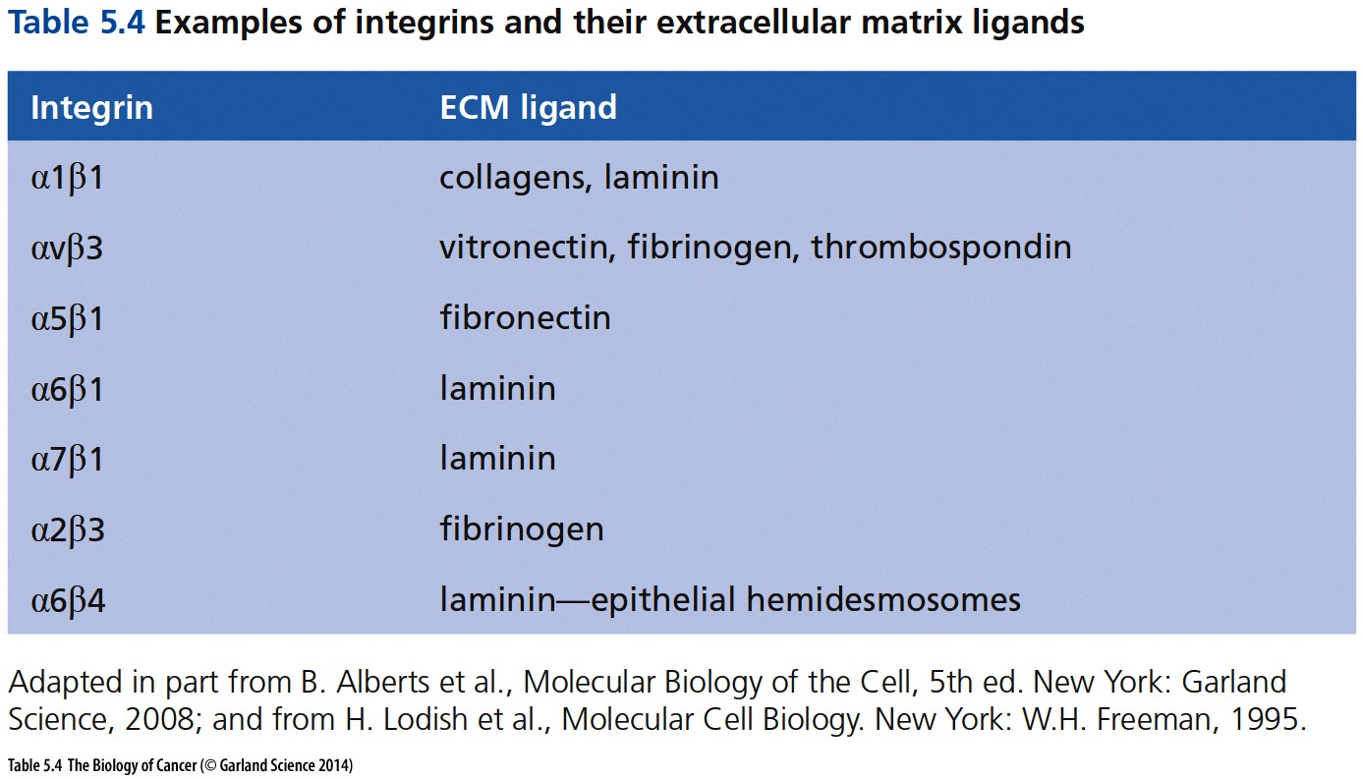
Notes:
供参考

Slide 66
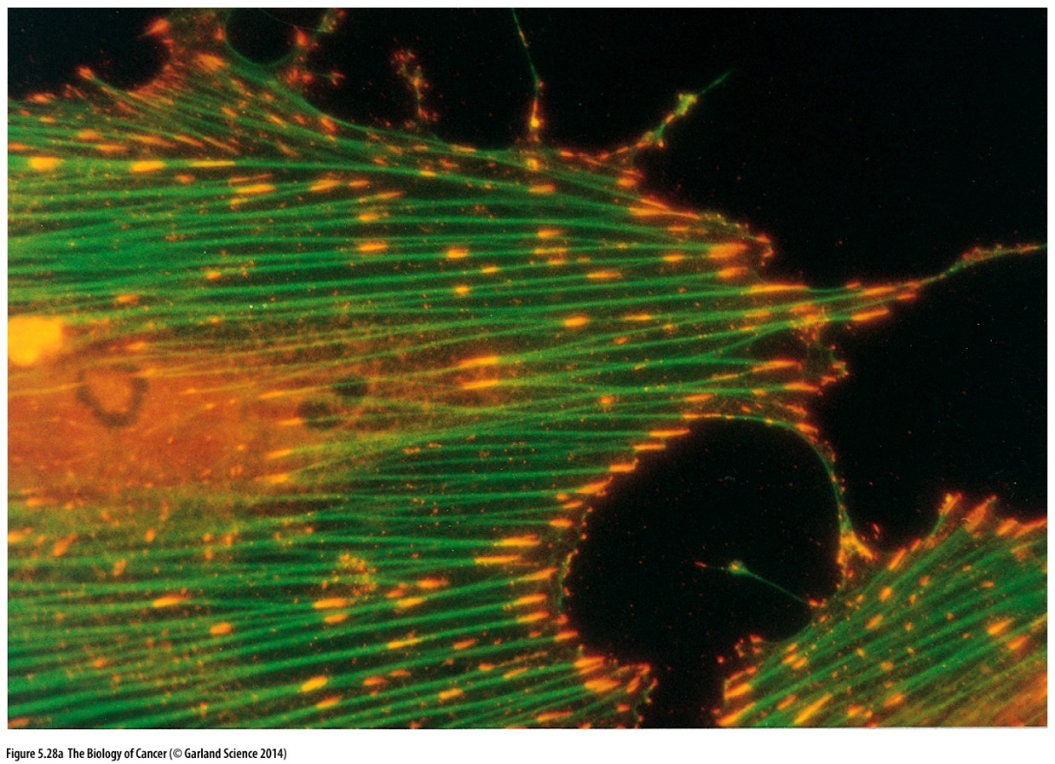
Figure 5.28 Integrin tethering to the ECM and cytoskeleton
This fluorescence micrograph illustrates the discrete elongated foci (yellow/orange) on the cell surface, termed focal adhesions(粘着斑), at which integrins tether cells to the extracellular matrix (ECM).
Notes:
非常形象的免疫荧光图

Slide 67
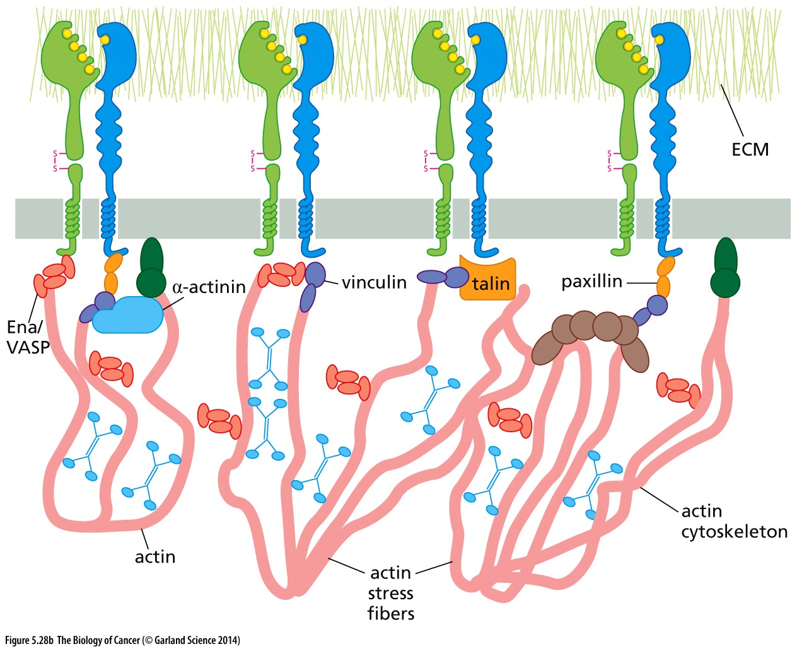
Figure 5.28 Integrin tethering to the ECM and cytoskeleton
This schematic figure of the organization of integrins indicates their association with the ECM through their ectodomains and their association with the actin cytoskeleton through their cytoplasmic domains via the β subunit of each heterodimer. A series of intermediary proteins, such as actinin, vinculin, and talin, allows these linkages to be formed.

Slide 68
5.10 The Ras protein functions as a G protein
Notes:
本次课最后一部分内容…

Slide 69
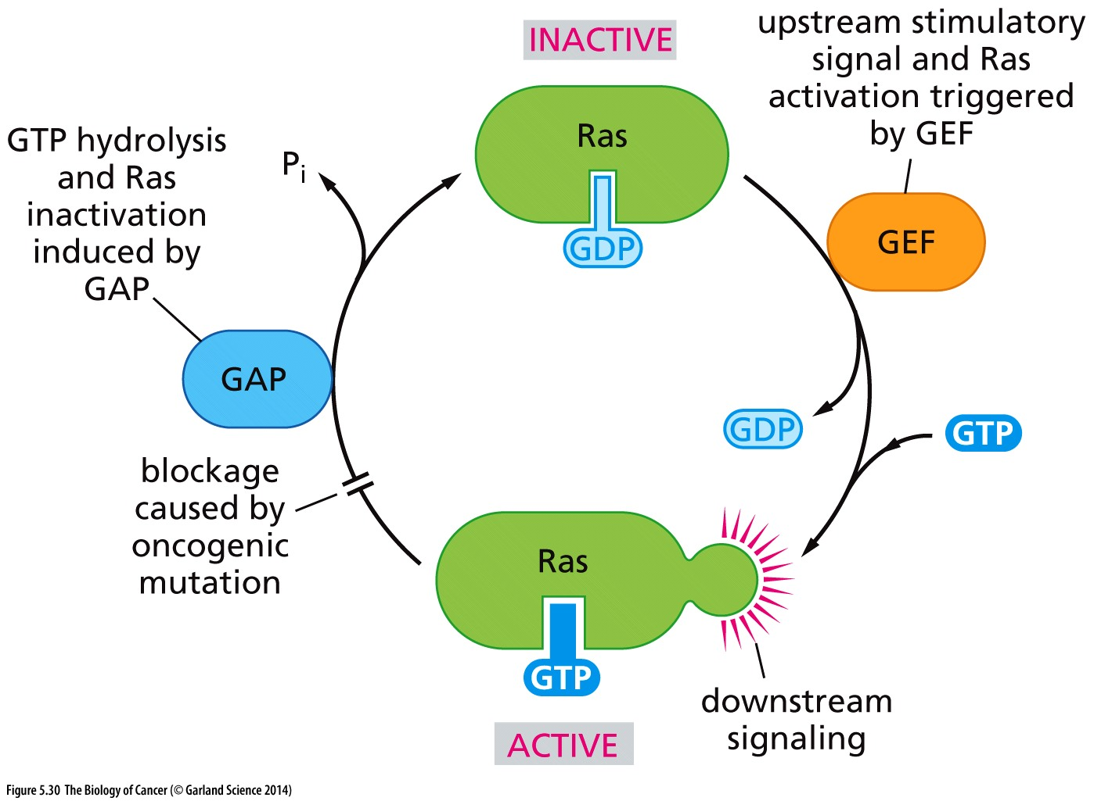
Figure 5.30 The Ras signaling cycle
Detailed study of the biochemistry of Ras proteins revealed that they, like the heterotrimeric G-proteins (see Figure 5.24B), operate as binary switches, binding GDP in their inactive state (top) and GTP in their active, signal-emitting state (bottom). Thus, an inactive, GDP binding Ras protein is stimulated by a GEF (guanine nucleotide exchange factor) to release its GDP and acquire a GTP in its stead, placing Ras in its active, signaling configuration. This period of signaling is soon halted by the actions of a GTPase activity intrinsic to Ras, which hydrolyzes GTP to GDP (left). This GTPase activity is strongly stimulated by GAPs (GTPase-activating proteins)
that Ras might encounter while in its activated state. Amino acid substitutions caused by oncogenic point mutations (see Figure 4.9) block this cycle by inactivating the intrinsic GTPase activity of Ras; this traps Ras in its activated, signal-emitting state.
Ras: Rat sarcoma virus oncogene
Notes:
非常重要的结论！

Slide 70
GAPs (GTPase-activating proteins). This interaction increases the GTPase activity of the Ras protein by as much as 100,000- fold and thus results in the rapid conversion of active, GTP-bound Ras into its inactive, GDP-bound form.
the Ras oncoprotein encoded by Harvey sarcoma virus. Like the normal Ras protein, the Ras oncoprotein could bind GTP. However, the oncoprotein was found to have lost virtually all GTPase activity (Figure 5.31A).

Slide 71
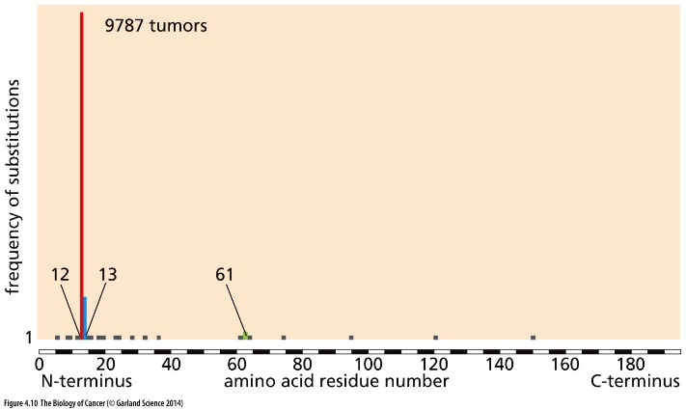
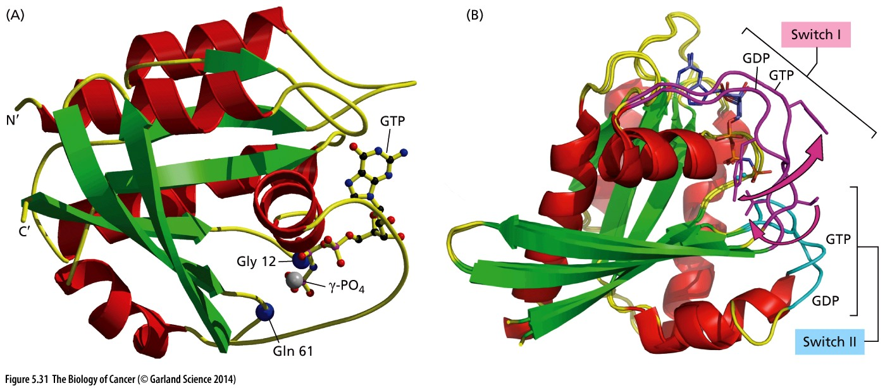
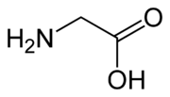
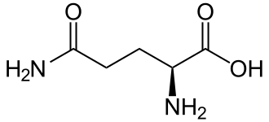
Figure 5.31 The structure of the Ras protein and its response to GTP binding
Glycine（甘氨酸）
Glutamine（谷氨酰胺）
The two amino acid residues often found altered in the Ras oncoproteins present in human tumors —glycine 12 and glutamine 61—are shown as dark blue balls. Their close association with the γ-phosphate of GTP (gray ball) helps to explain why substitutions of these residues reduce or eliminate the Ras protein’s GTPase activity
Notes:
How to target mutated Ras for cancer treatment?

Slide 72
课后作业
1, 简述v-ErbB蛋白和EGFR蛋白的异同点，以及v-ErbB蛋白保持活性的机制。
2, 简述receptor tyrosine kinase激活的机制以及相关实验证据。
3, GPCR偶联的G蛋白（heterotrimeric G-proteins ）和Ras 的相同点和不同点。

